Slide 1
An NSS Audio-Visual
Library Presentation
A Photographic Tour of the Caves of the National Parks
Bruce Bannerman and Karen Kastning, 1994
S918 140 Slides 2/18/2021

Slide 2
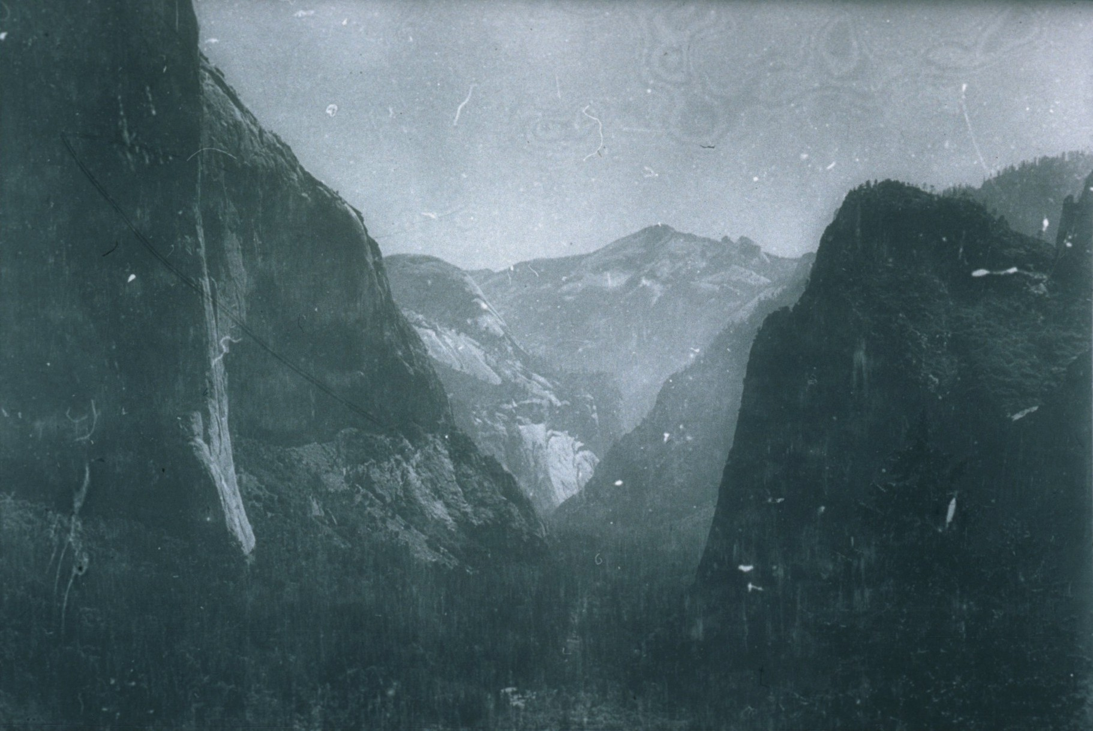
Notes:
In the 1800s men such as Galen Clark, John Muir, and I. W. Raymond labored… (Photo NPS/B&W – View of Yosemite Valley)

Slide 3
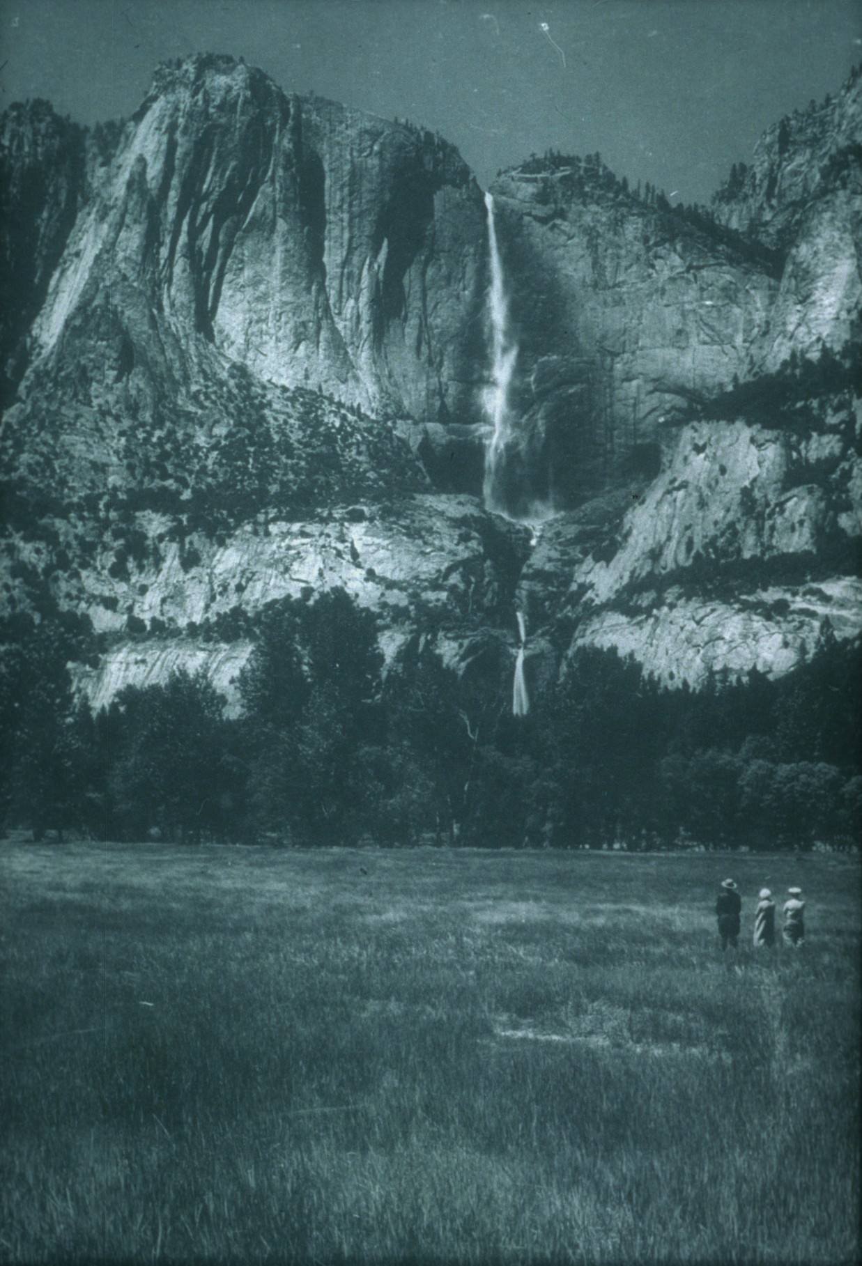
Notes:
…to have wilderness areas of California preserved for future generations. (Photo NPS/B&W – View of Yosemite Valley and waterfall)

Slide 4
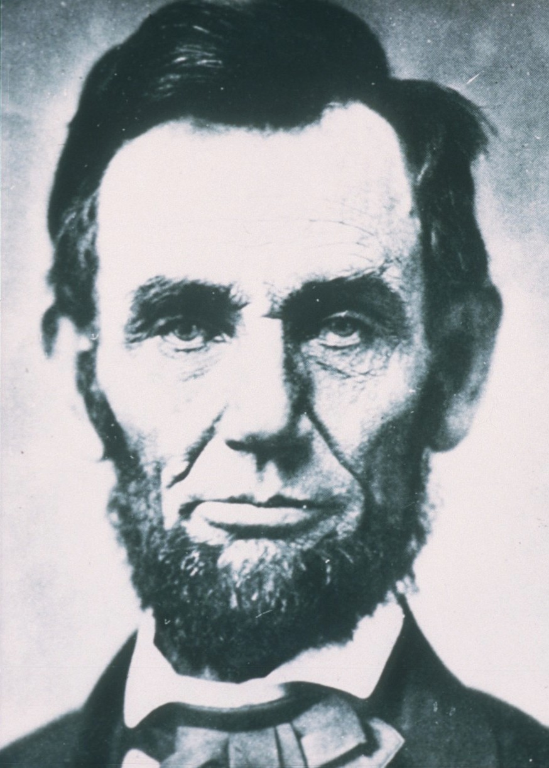
Notes:
With our country torn in civil war, President Abraham Lincoln signed the Yosemite Grant… (Photo NPS/B&W – Portrait of President Lincoln)

Slide 5
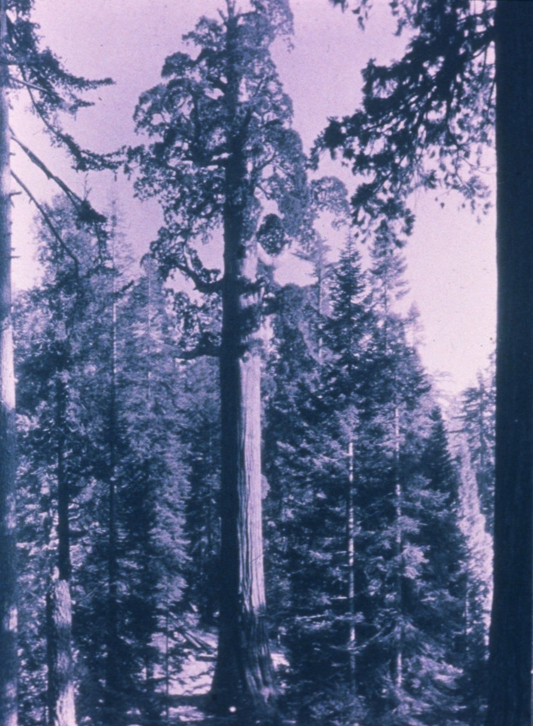
Notes:
…placing the Mariposa Grove and the Yosemite area under the protection of the state of California. (Photo NPS/B&W – View of trees in Mariposa Grove)

Slide 6
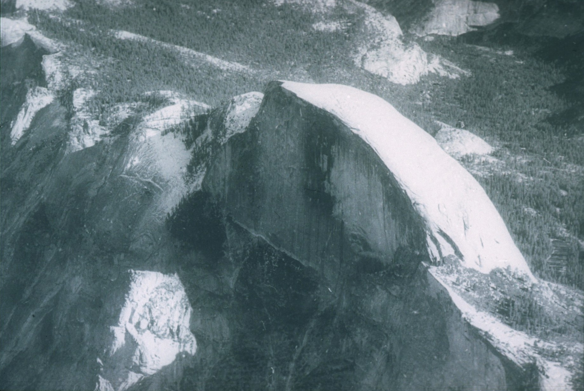
Notes:
…sowing the seed of an idea for government-managed recreation areas. (Photo NPS/B&W – View of Half-Dome in Yosemite NP)

Slide 7
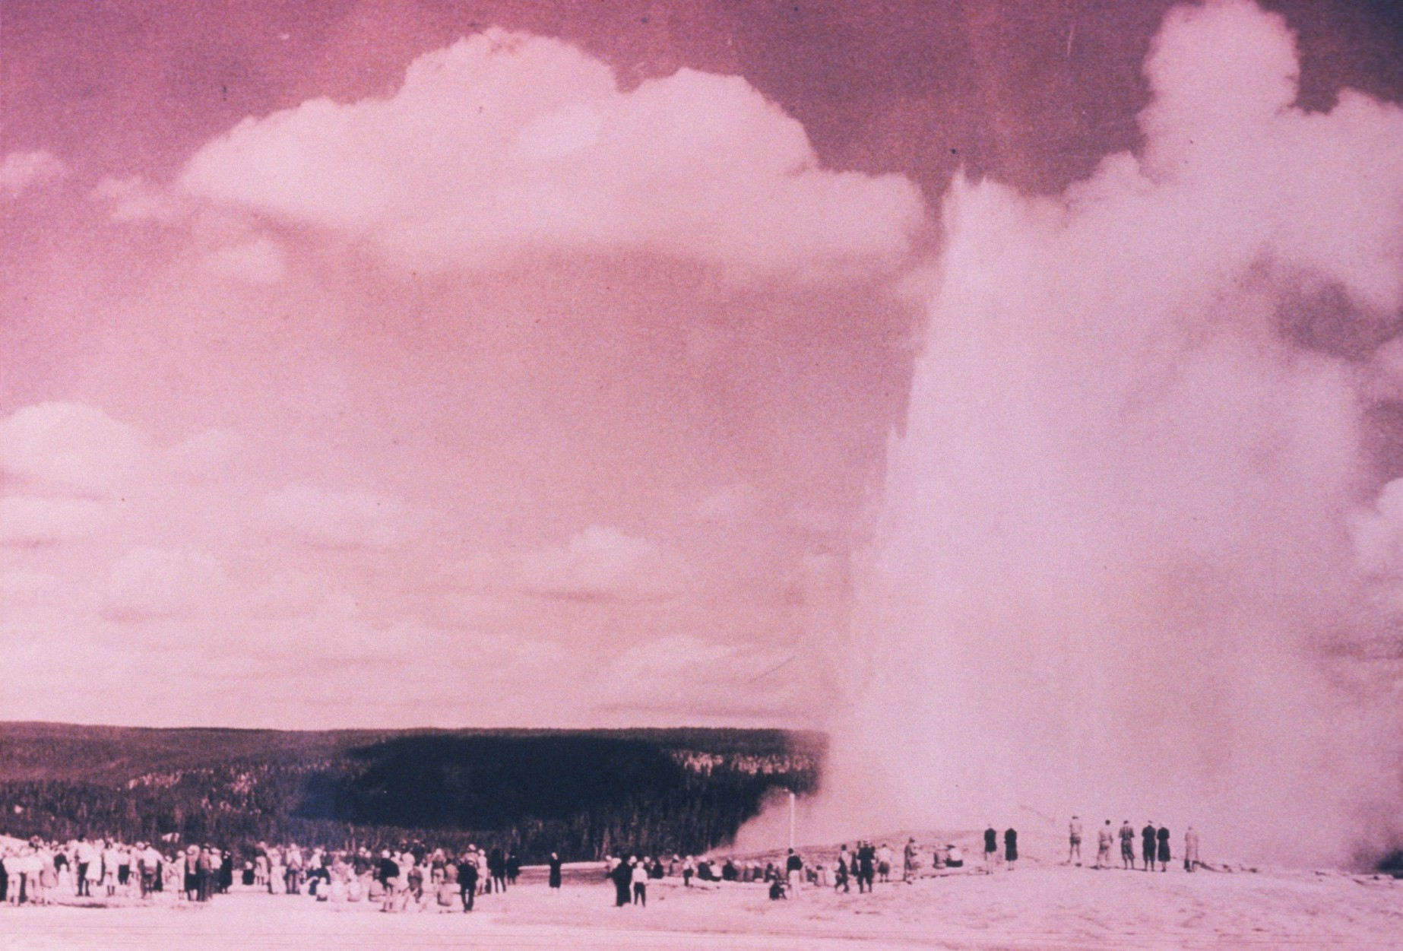
Notes:
That seed sprouted when, as a result of the Washburn and Haden Expeditions, the Yellowstone Park Bill… (Photo NPS/B&W – View of Old Faithful in Yellowstone NP)

Slide 8
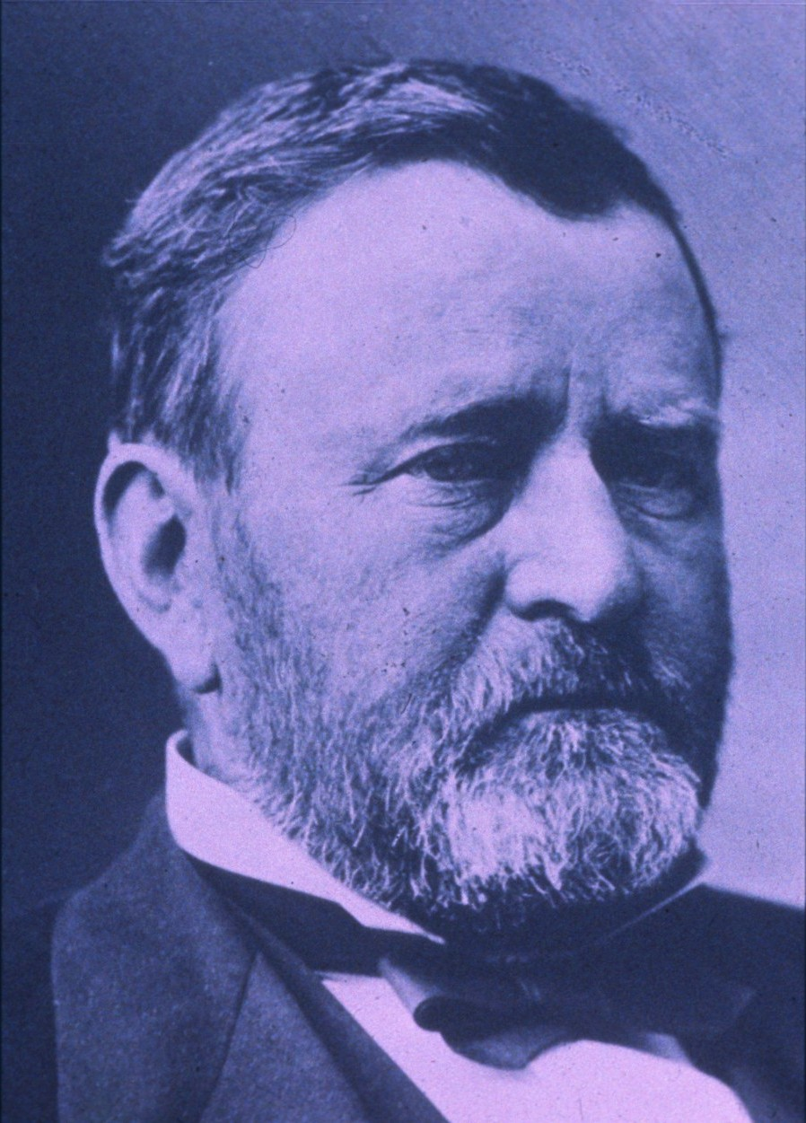
Notes:
…was signed by President Grant in 1872. (Photo NPS/B&W – Portrait of President Grant)

Slide 9
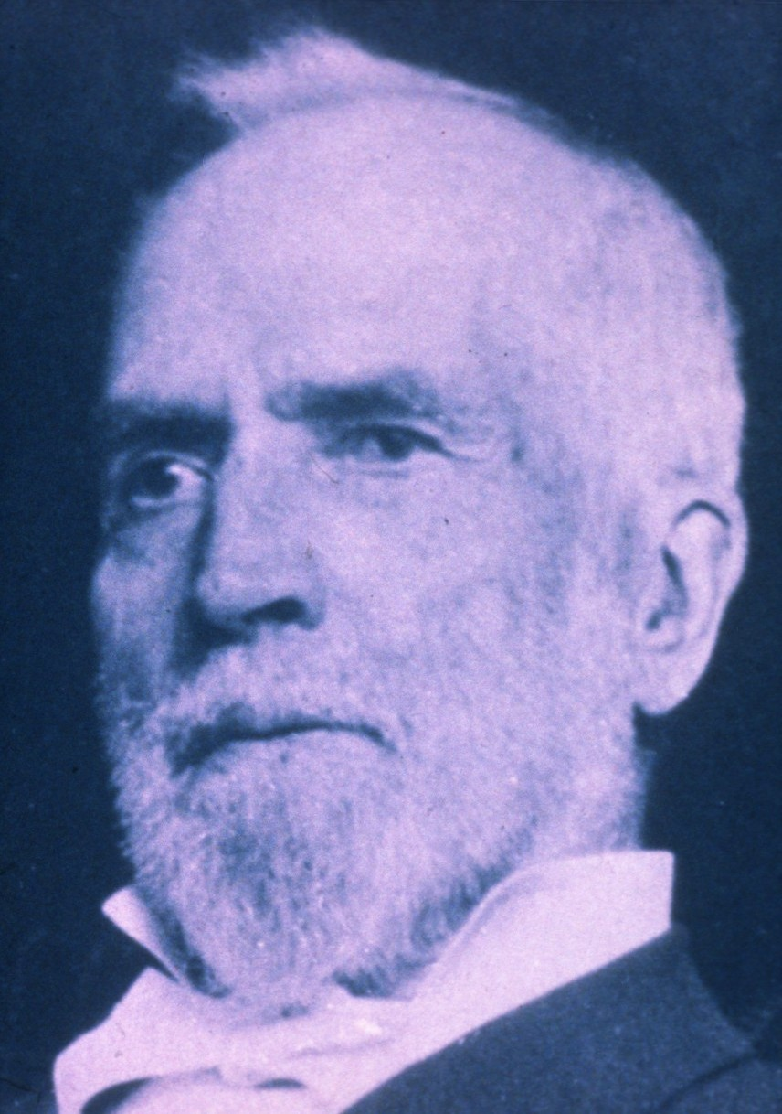
Notes:
Nathaniel Langford was appointed the first Superintendent and served for 5 years … without pay nor Park Appropriation. (Photo NPS/B&W – Portrait of Nathaniel Langford)

Slide 10
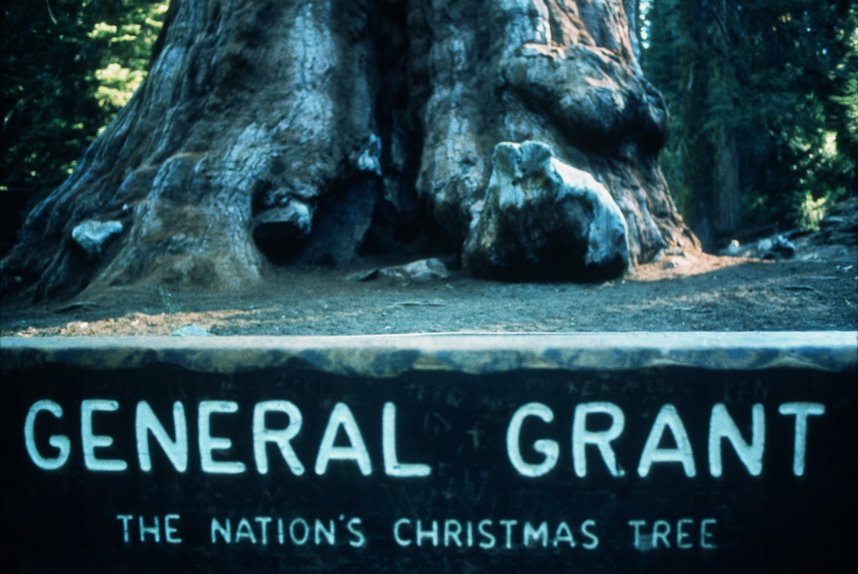
Notes:
The seedling was nurtured in 1890 when, with the encouragement of conservationists, Congress established General Grant, Sequoia, and Yosemite National Parks. (Photo NPS/B&W – View of the sign for General Grant NP)

Slide 11
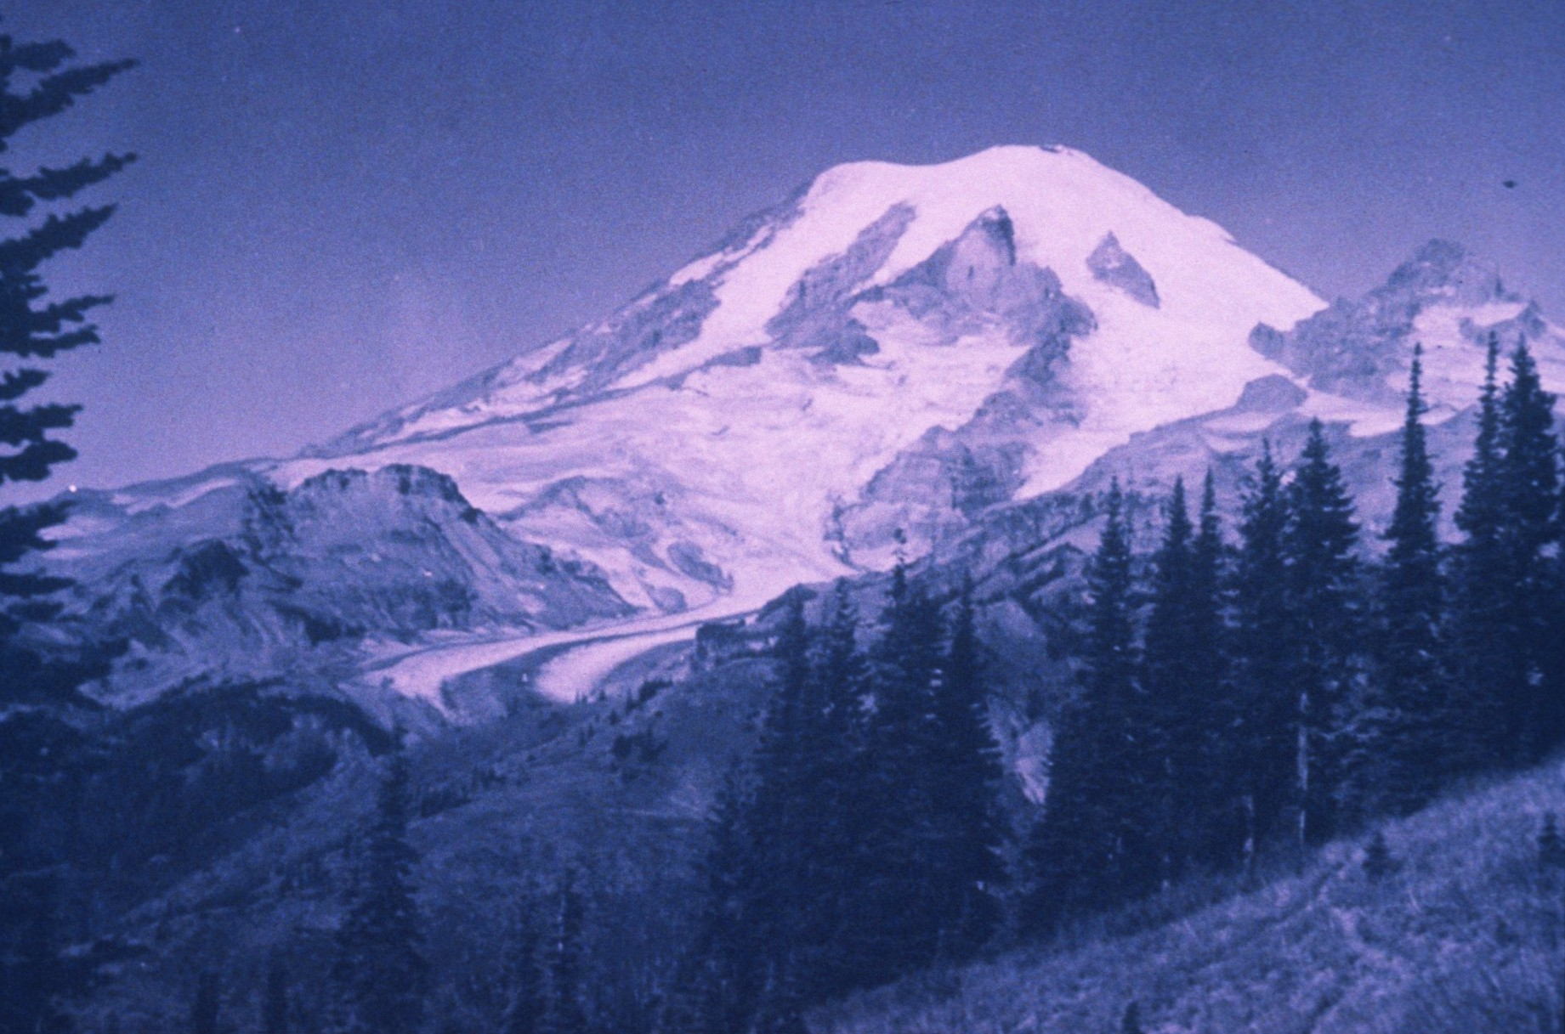
Notes:
In 1899 Mt. Rainier became the 5th national park. (Photo NPS/B&W – View of Mt. Rainier)

Slide 12
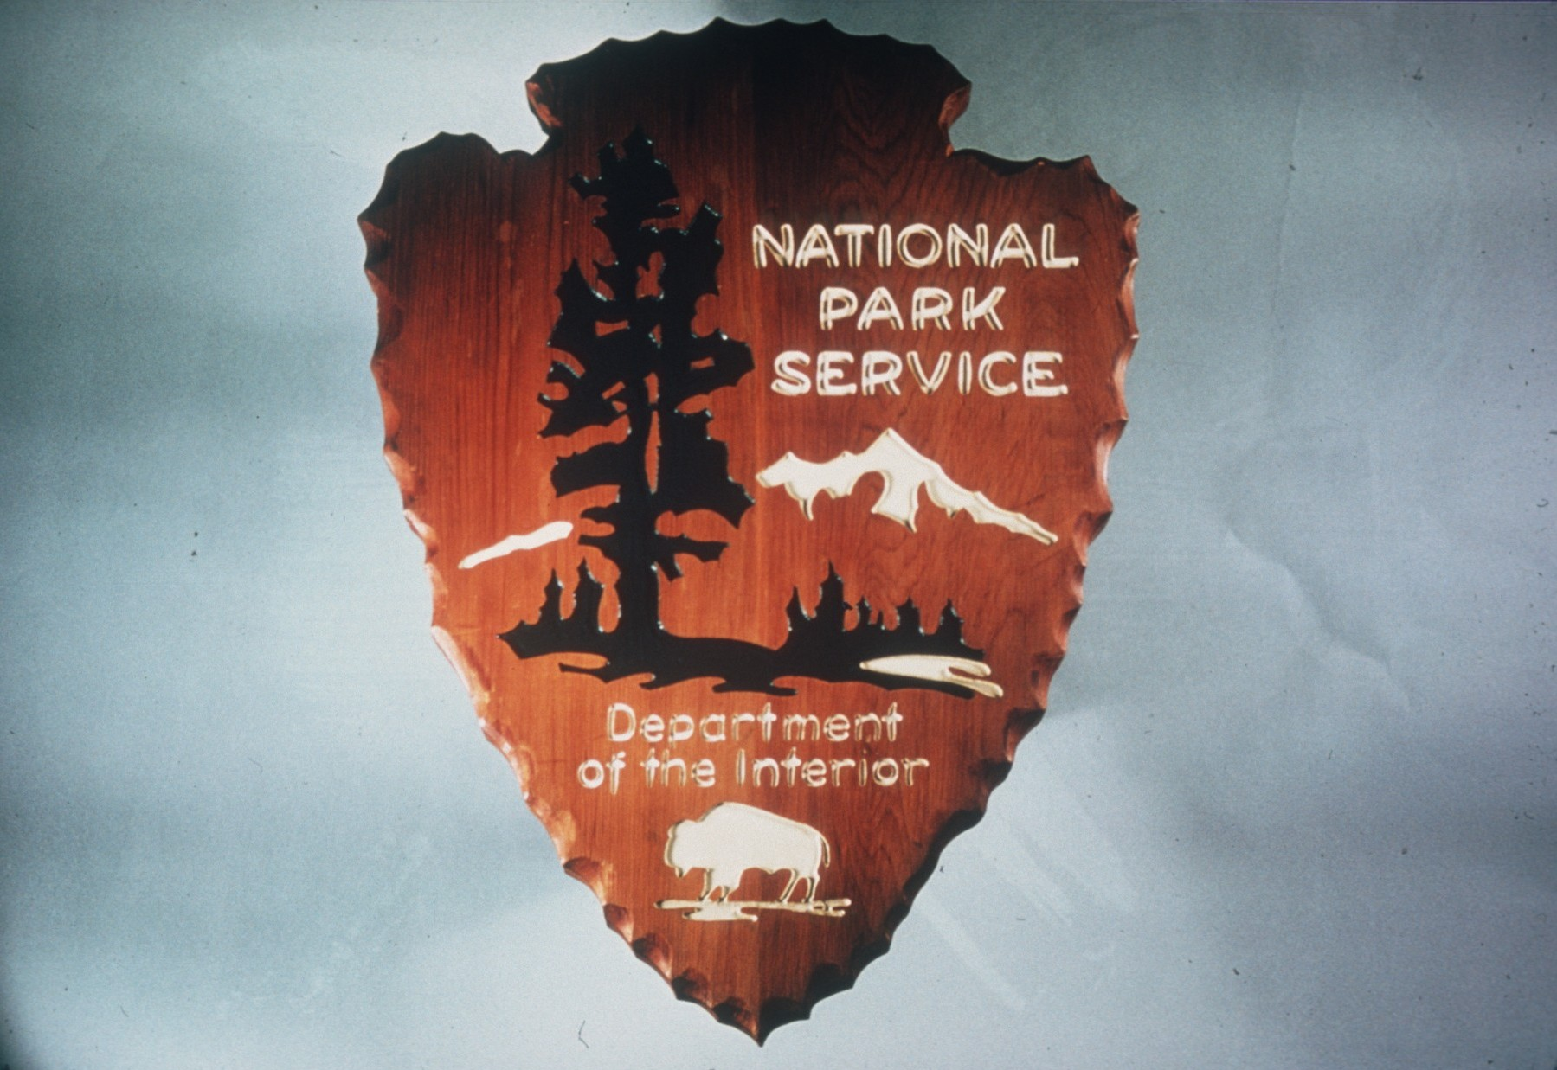
Notes:
52 years after Lincoln sowed the seed and 38 years after Grant established the first national park, Congress passed the National Parks Act. (Photo NPS/Color – National Park Service logo)

Slide 13
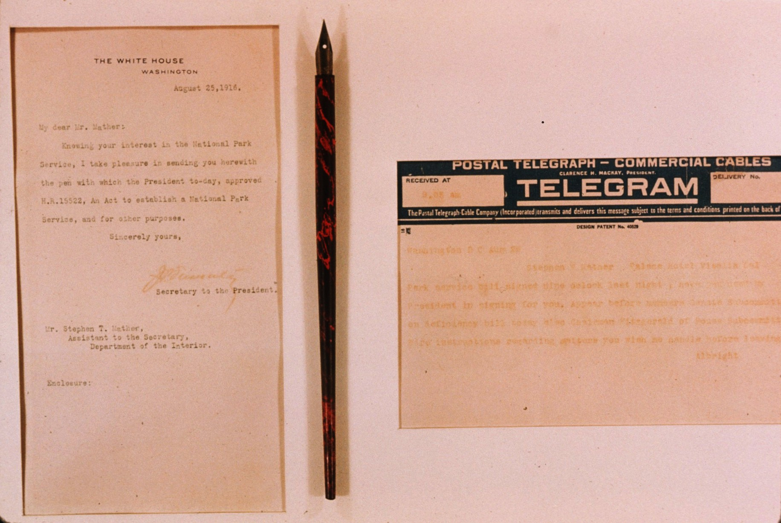
Notes:
It was 1916. (Photo NPS/Color – Copy of Telegram, pen, and signed paper)

Slide 14
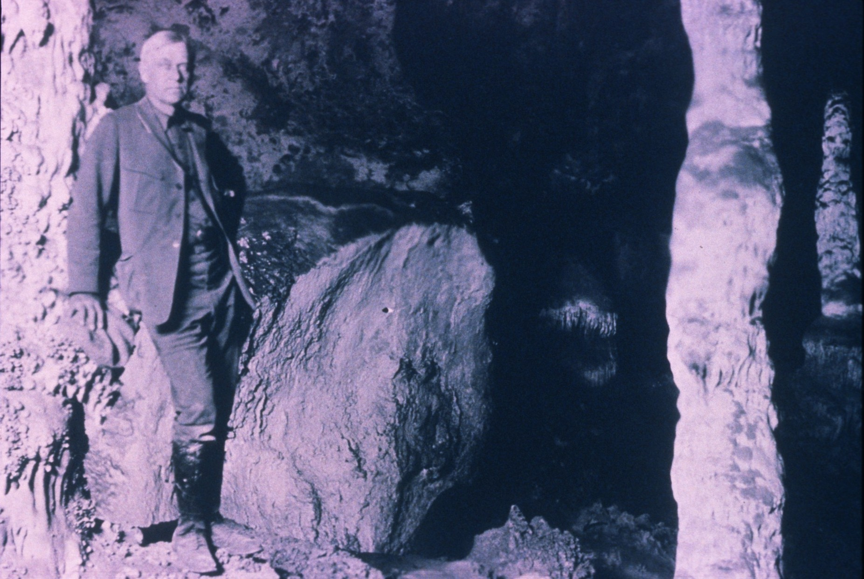
Notes:
Chicago businessman, Steven T. Mather, become the first director. A dedicated and energetic man, he recognized the need… (Photo NPS/Color – View of Mather in Carlsbad Caverns)

Slide 15
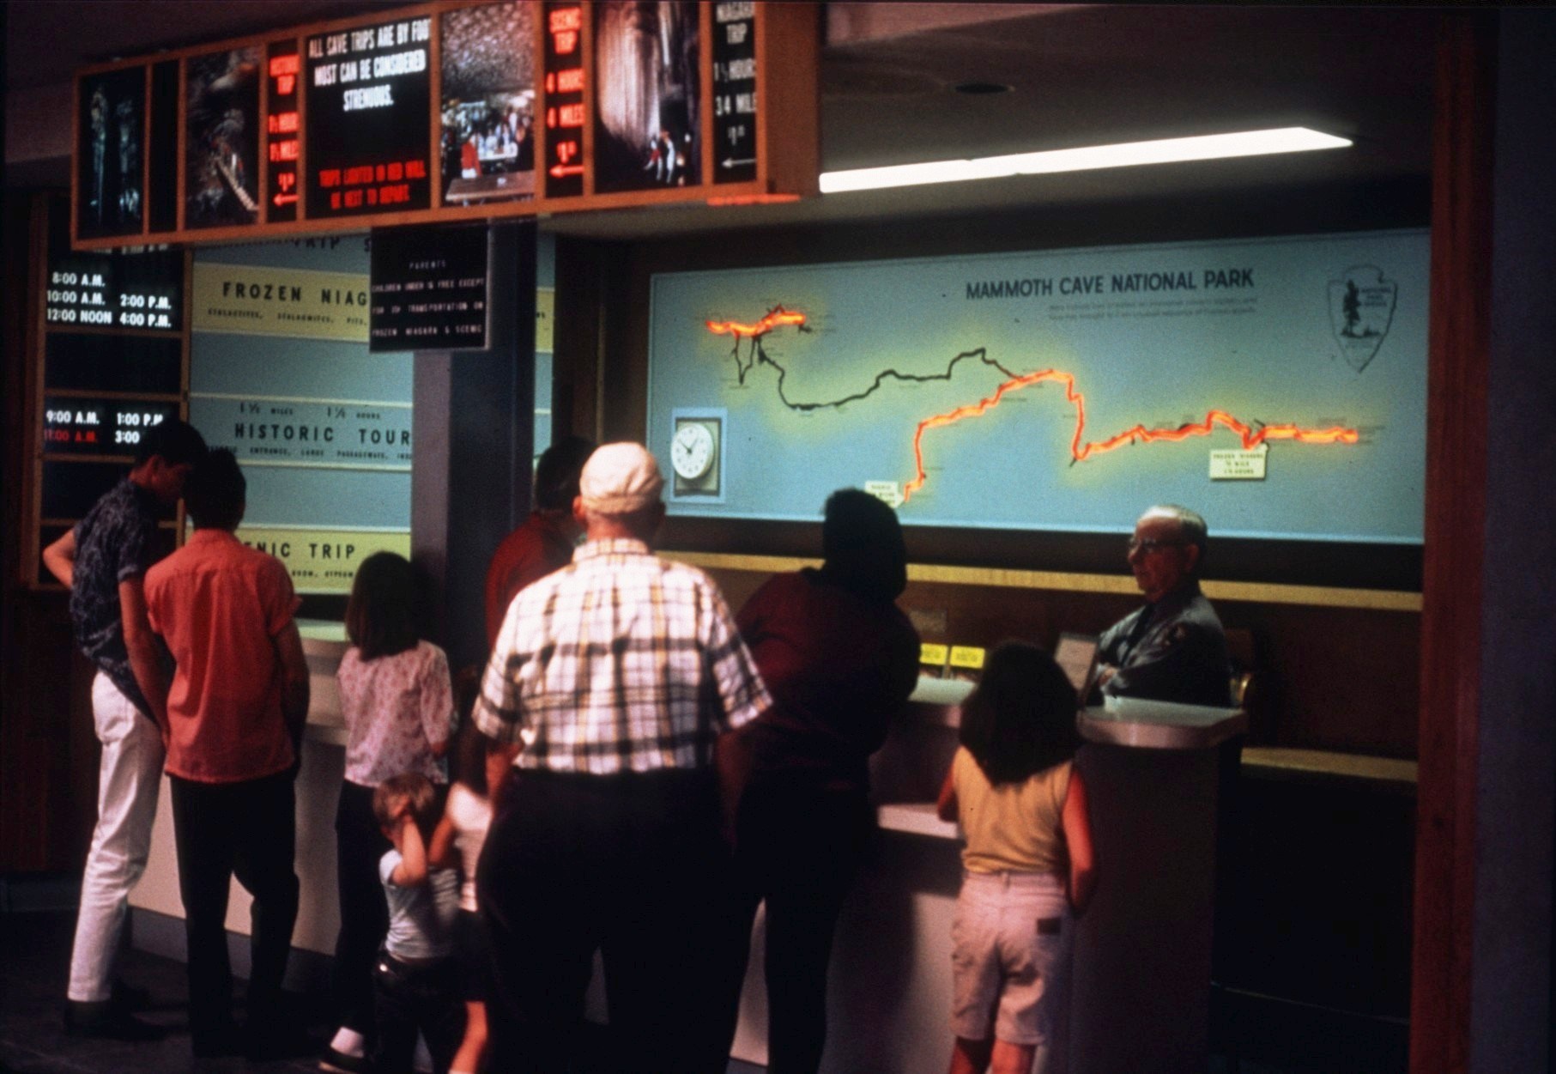
Notes:
…for education and interpretive work in the parks. (Photo NPS/Color – View in Mammoth Cave Visitors’’ Center)

Slide 16
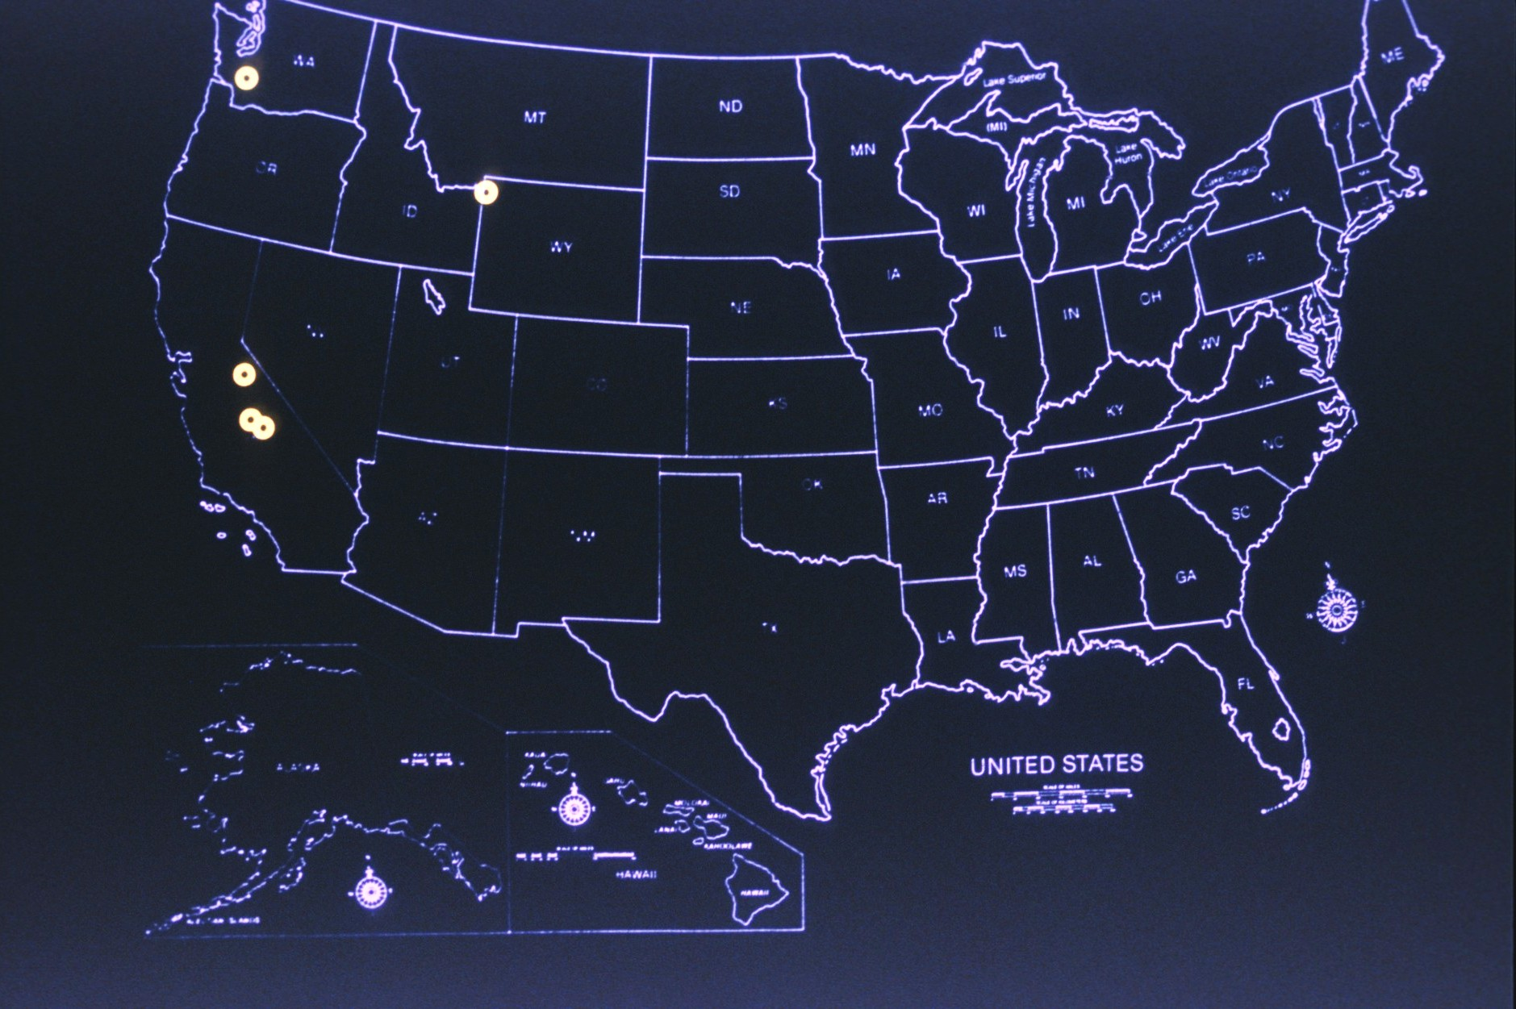
Notes:
From the first few unspoiled areas, more and more natural and historic areas have been added to the National Park Service. (Graphic: Bannerman/Color map showing locations of the five earliest parks of the U.S.)

Slide 17
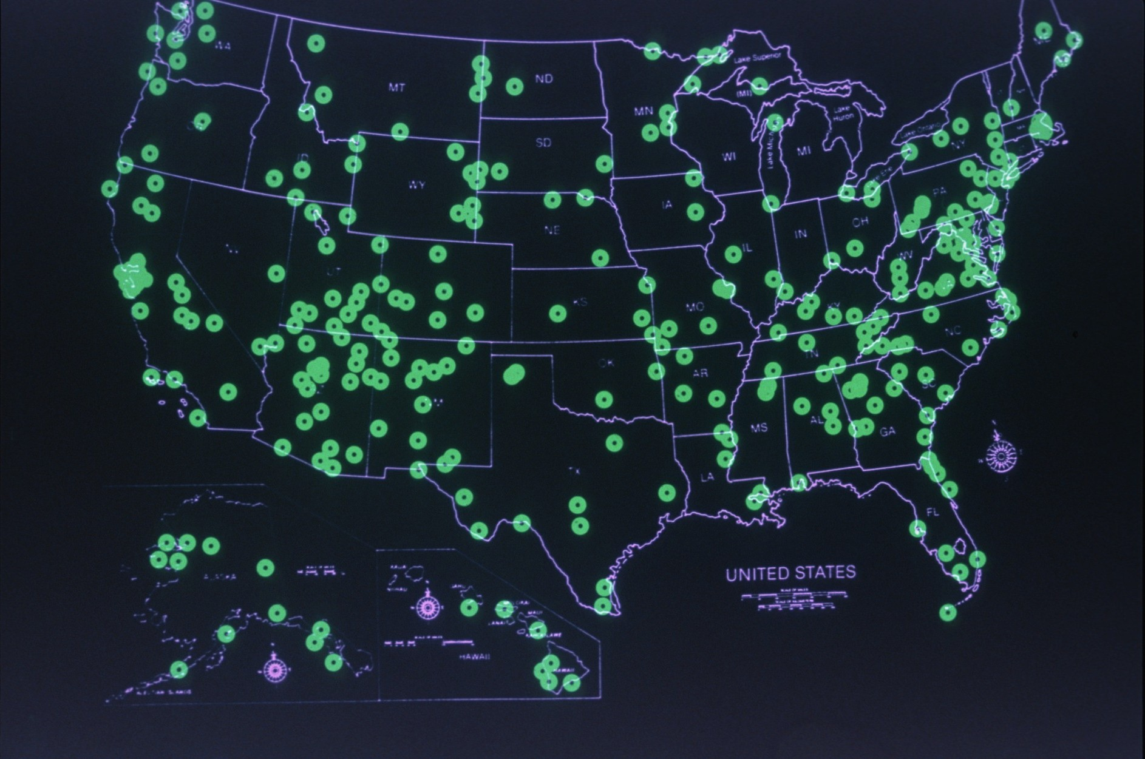
Notes:
Today there are over 300 national parks, rivers, historic sites, and other areas that are preserved for future generations. (Graphic: Bannerman/Color map showing over 300 parks of the U.S.)

Slide 18
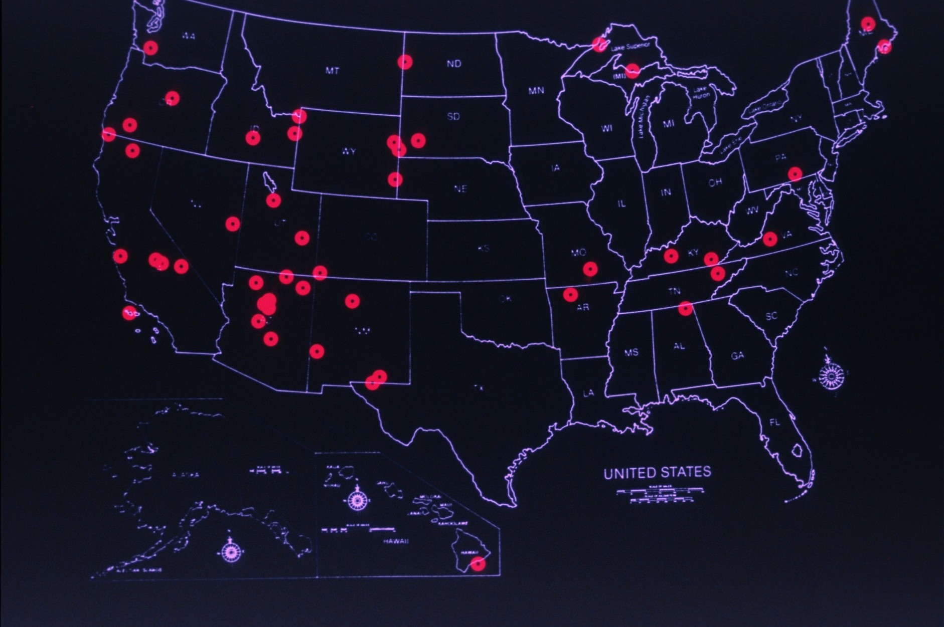
Notes:
Several of these properties have significant caves within their boundaries. (Graphic: Bannerman/Color map showing locations of the seventy-eight national parks with caves.)

Slide 19
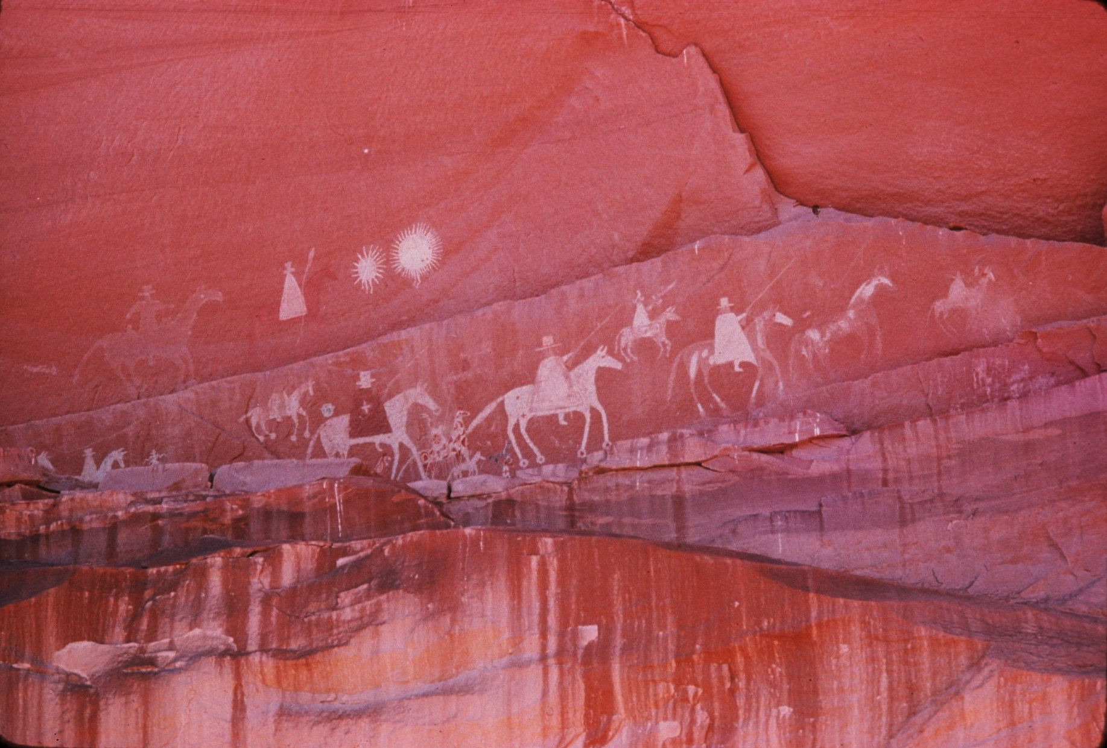
Notes:
Humanity, since its beginning, through need and curiosity, has been drawn to caves… (Photo: NPS/Color – View of pictograph)

Slide 20
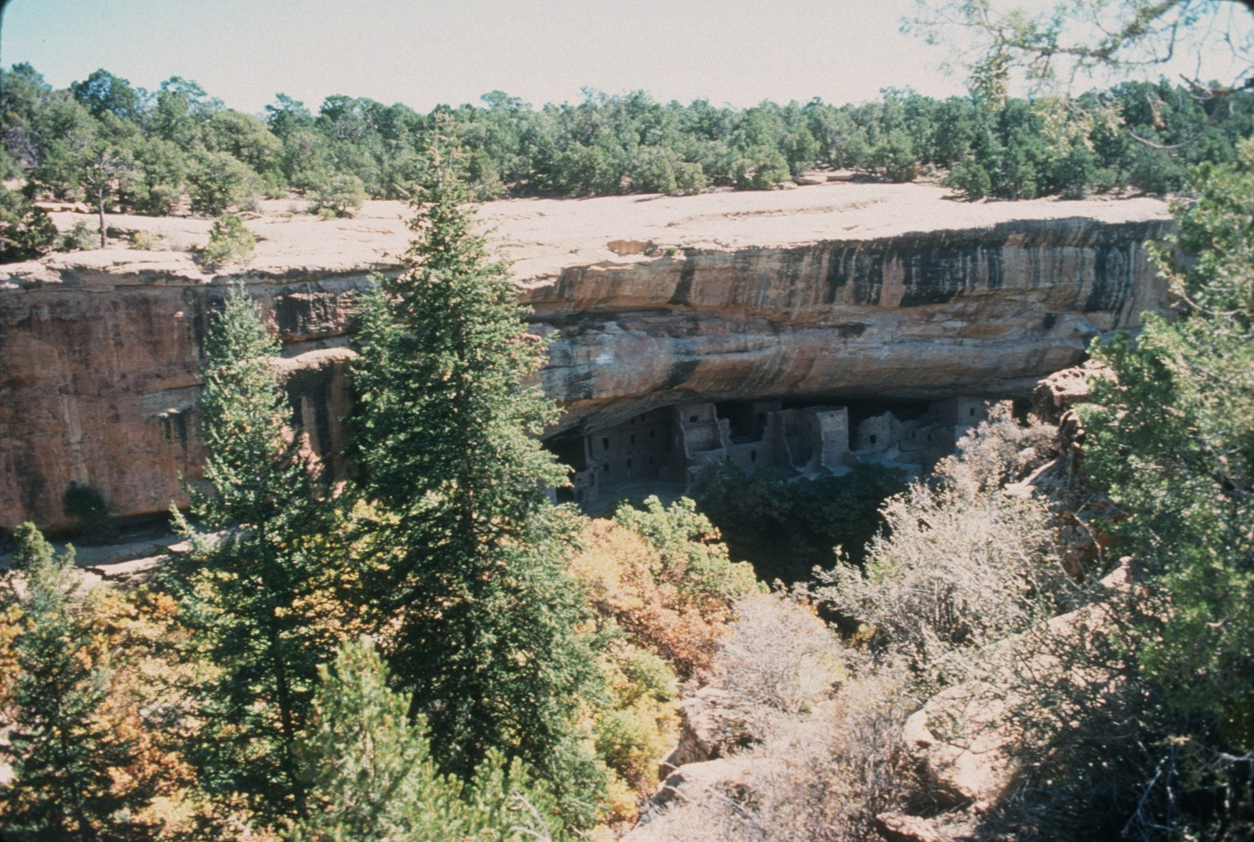
Notes:
…for shelter… (Photo: Cronk/Color – View of Spruce Tree House in Mesa Verde NP)

Slide 21
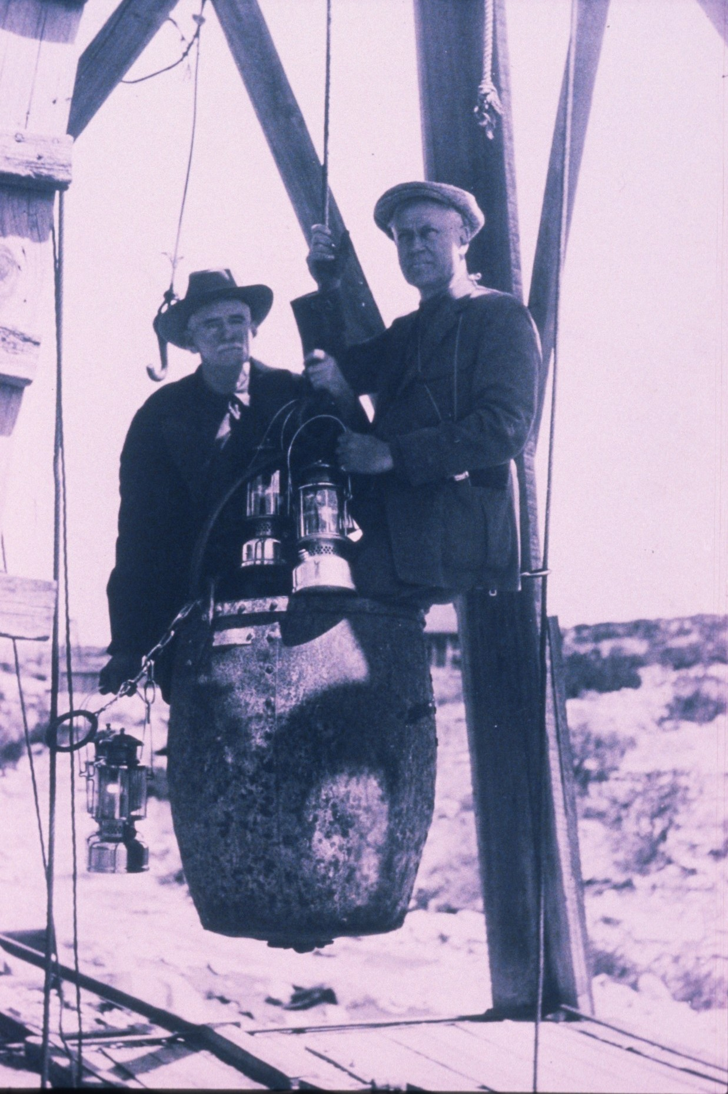
Notes:
…commerce (such as guano and saltpetre mining)… (Photo: NPS/B&W – View of guano bucket in Carlsbad Caverns, showing Mather on right)

Slide 22
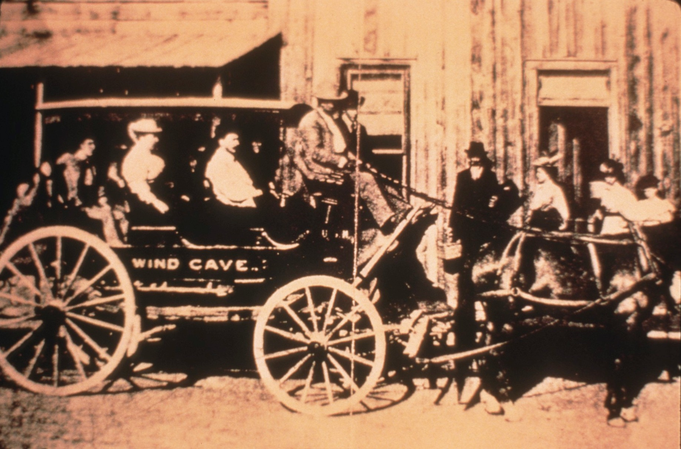
Notes:
…and recreation… (Photo: Scheltens/Color – View of Wind Cave stagecoach c. 1890)

Slide 23
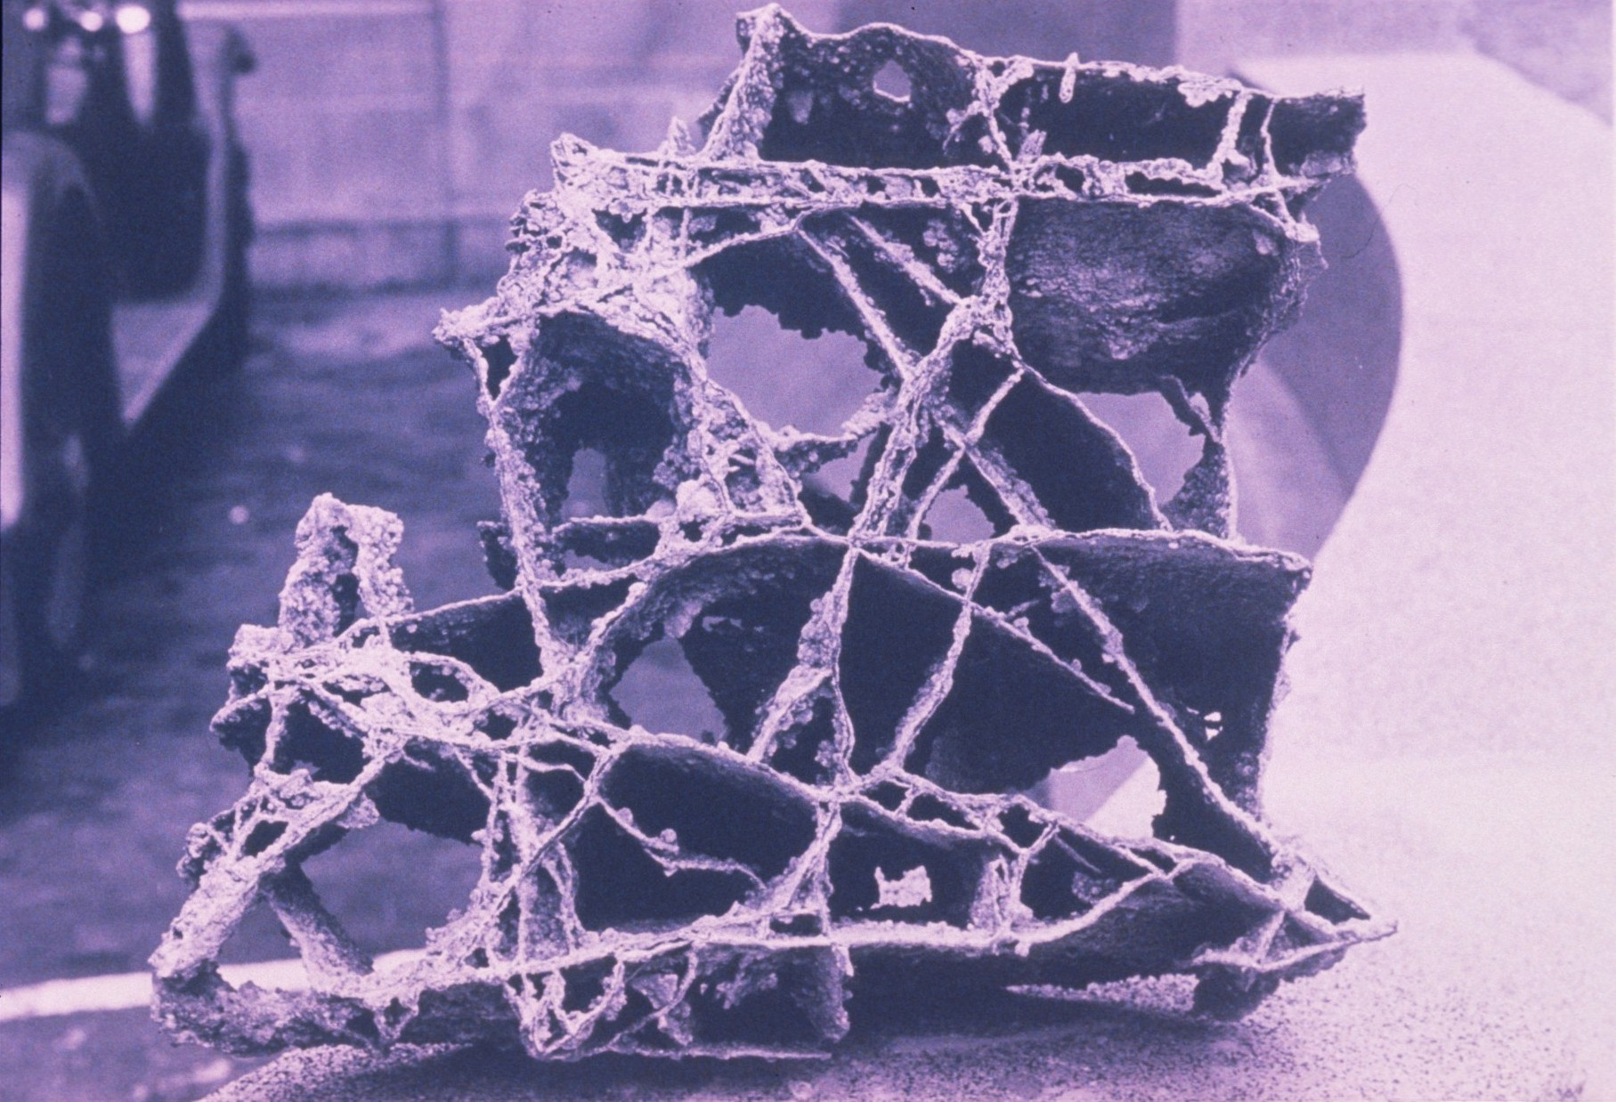
Notes:
…without understanding the impact… (Photo: NPS/Color – View of broken boxwork removed from Wind Cave)

Slide 24
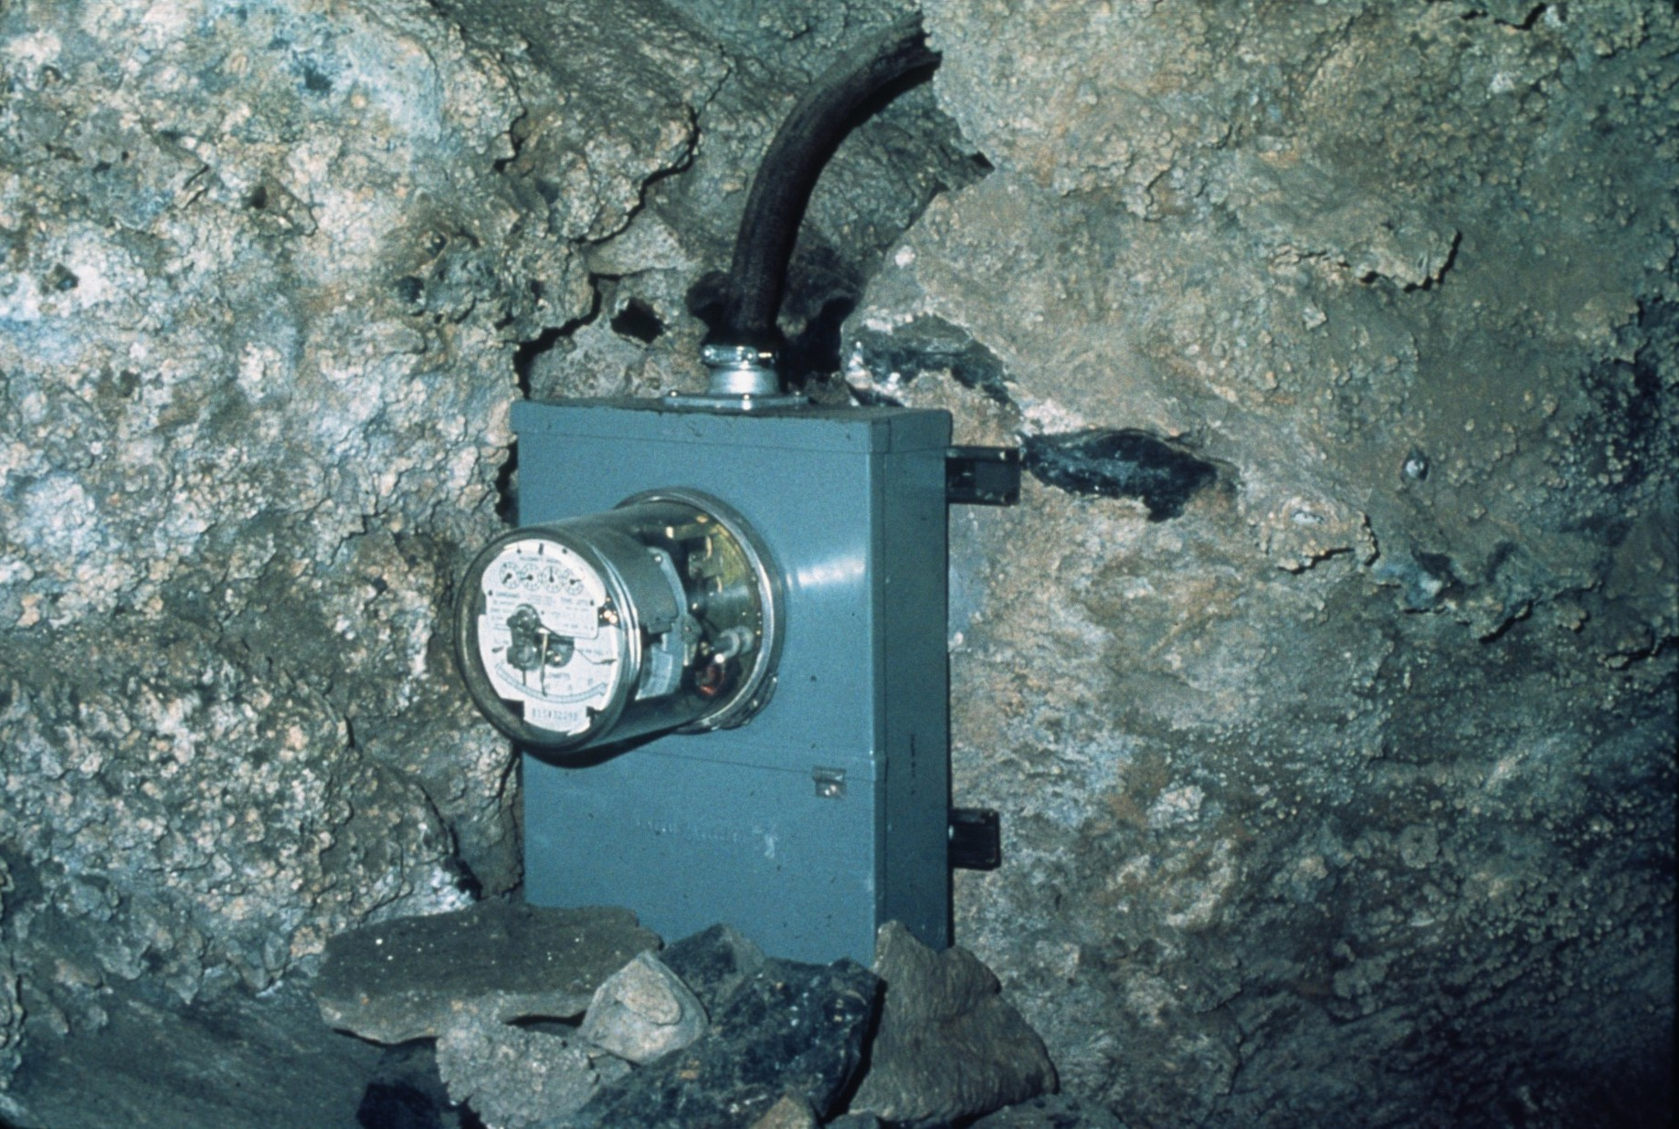
Notes:
…on the delicate… (Photo: NPS/Color – View of electric meter box in Timpanogos Cave)

Slide 25
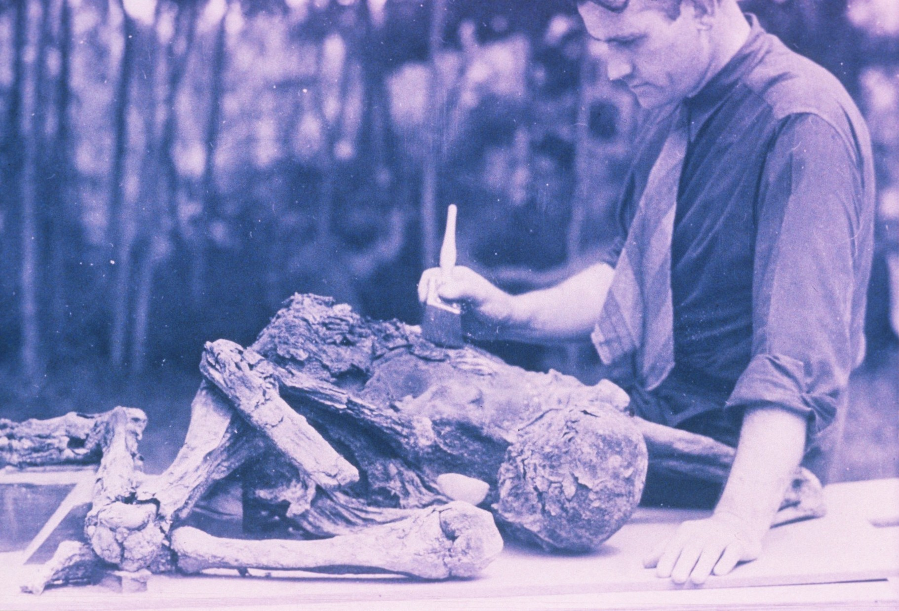
Notes:
…cave environment. (Photo: NPS/Color – View of mummy from Mammoth Cave)

Slide 26
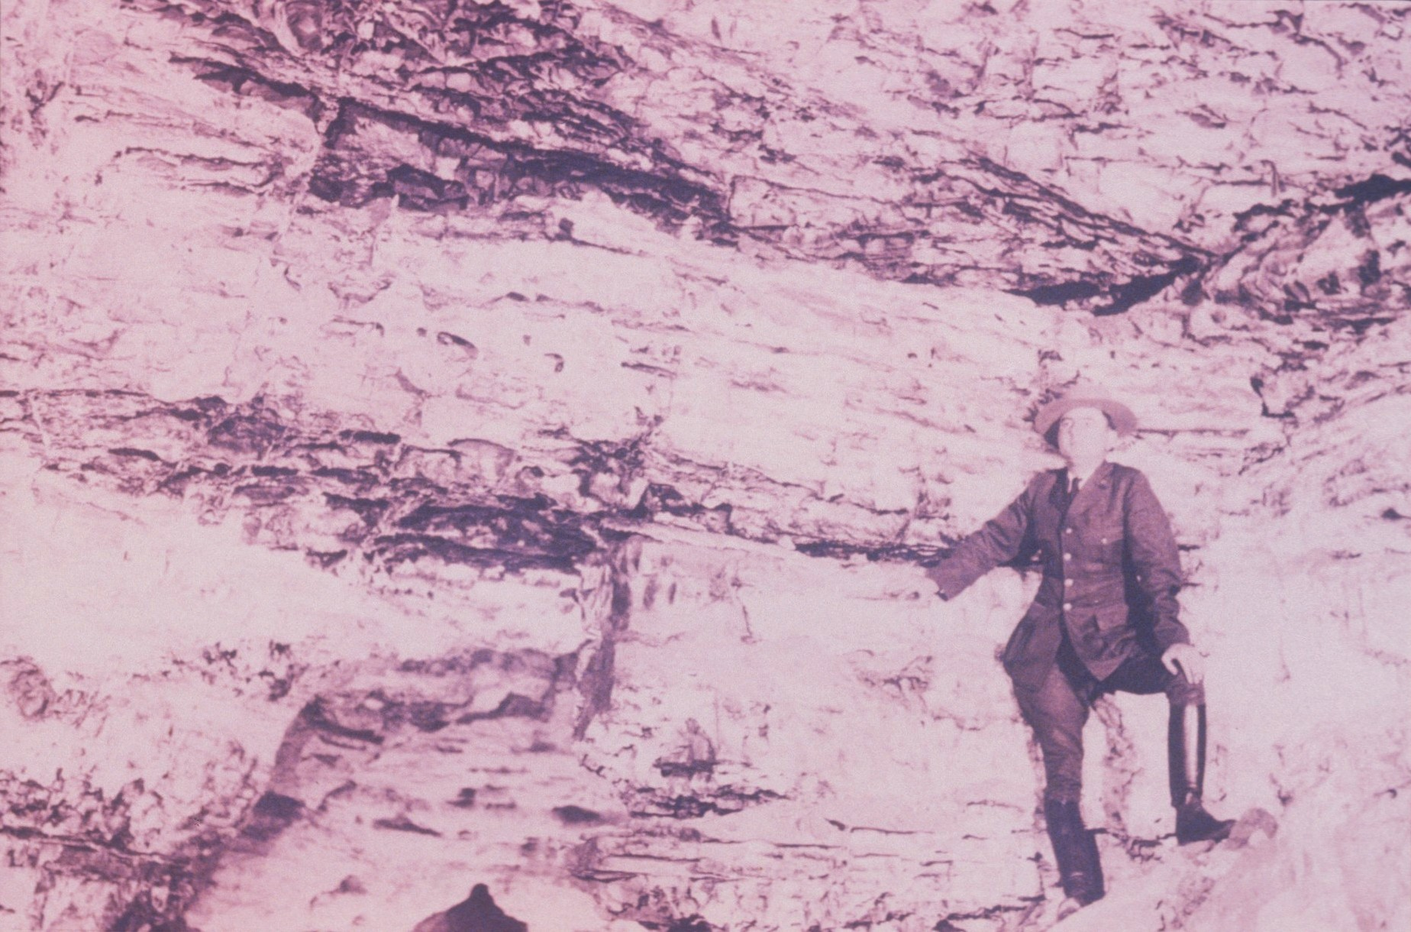
Notes:
Finally, those with a special interest in caves began to realize the potential problems… (Photo: NPS/B&W – View of NPS ranger at wall)

Slide 27
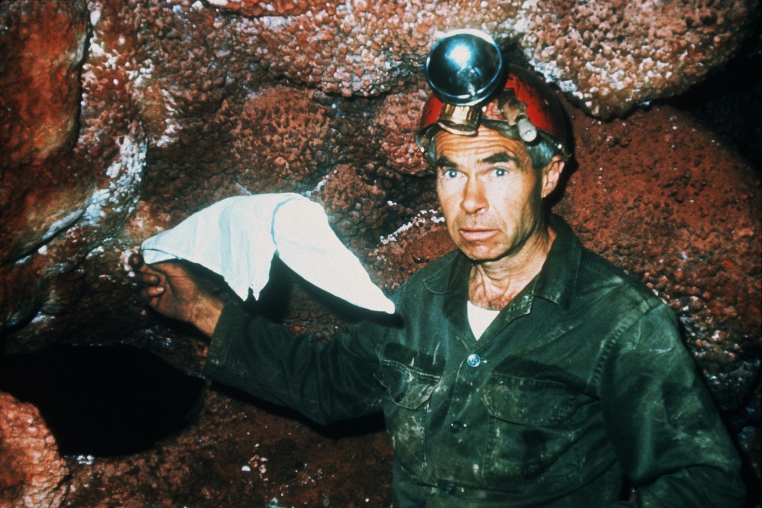
Notes:
…of a failure to understand the underground wilderness. (Photo: NPS/Color – View of Herb Conn doing a wind demonstration at Jewel Cave)

Slide 28
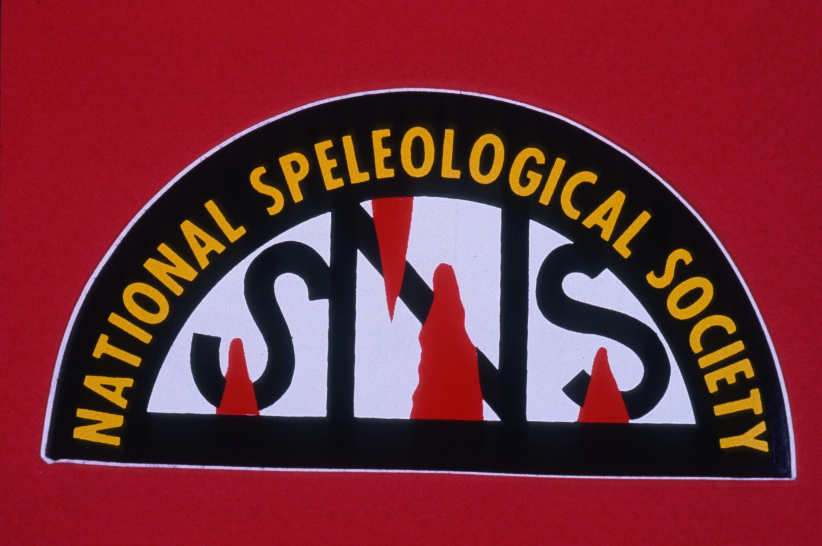
Notes:
The National Speleological Society was founded in 1941, for the purpose… (Photo: Kastning/Color – National Speleological Society logo)

Slide 29
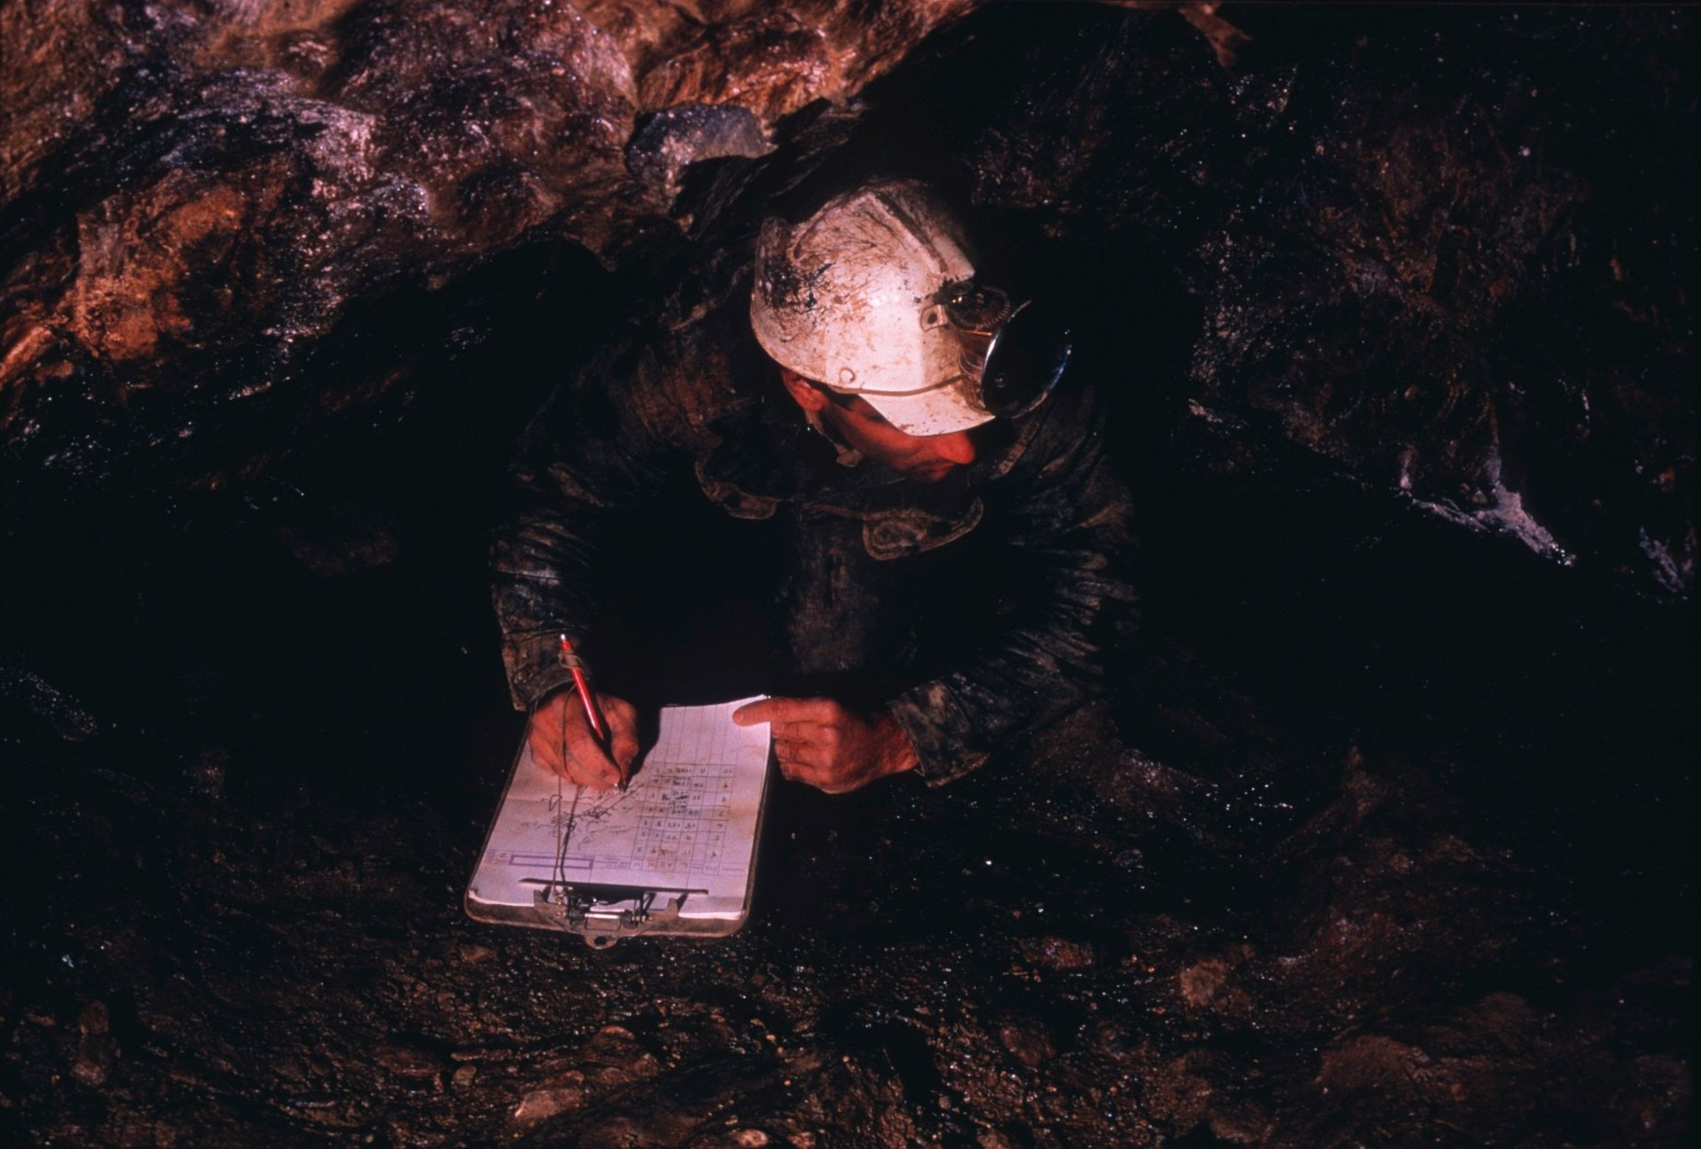
Notes:
…of promoting the study and science of speleology… (Photo: Kastning/Color – View of Art Palmer mapping in Bentley’s Cave, NY)

Slide 30
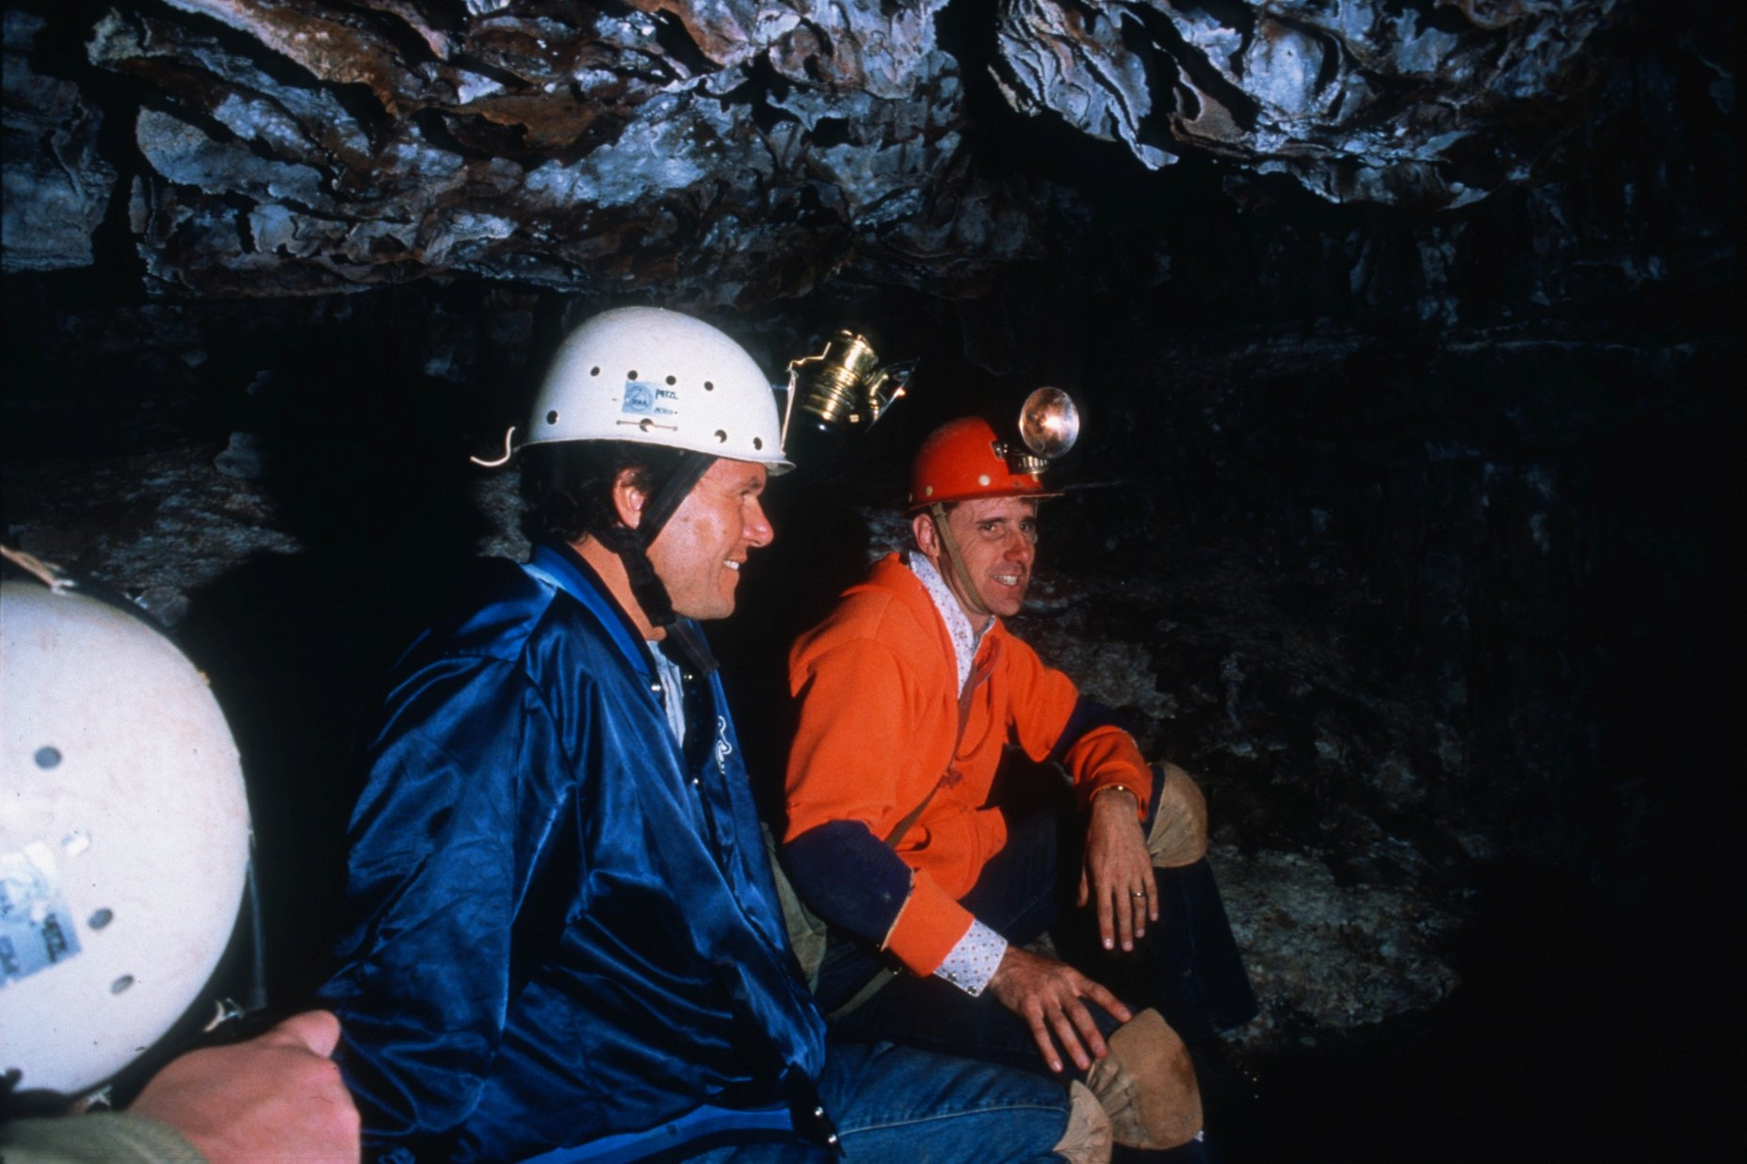
Notes:
…and the protection of caves and their natural contents. Continuing the works of Clark, Muir, Mather, and many others, (Photo: Scheltens/Color – View of Senator Tom Daschle and John Scheltens in Wind Cave)

Slide 31
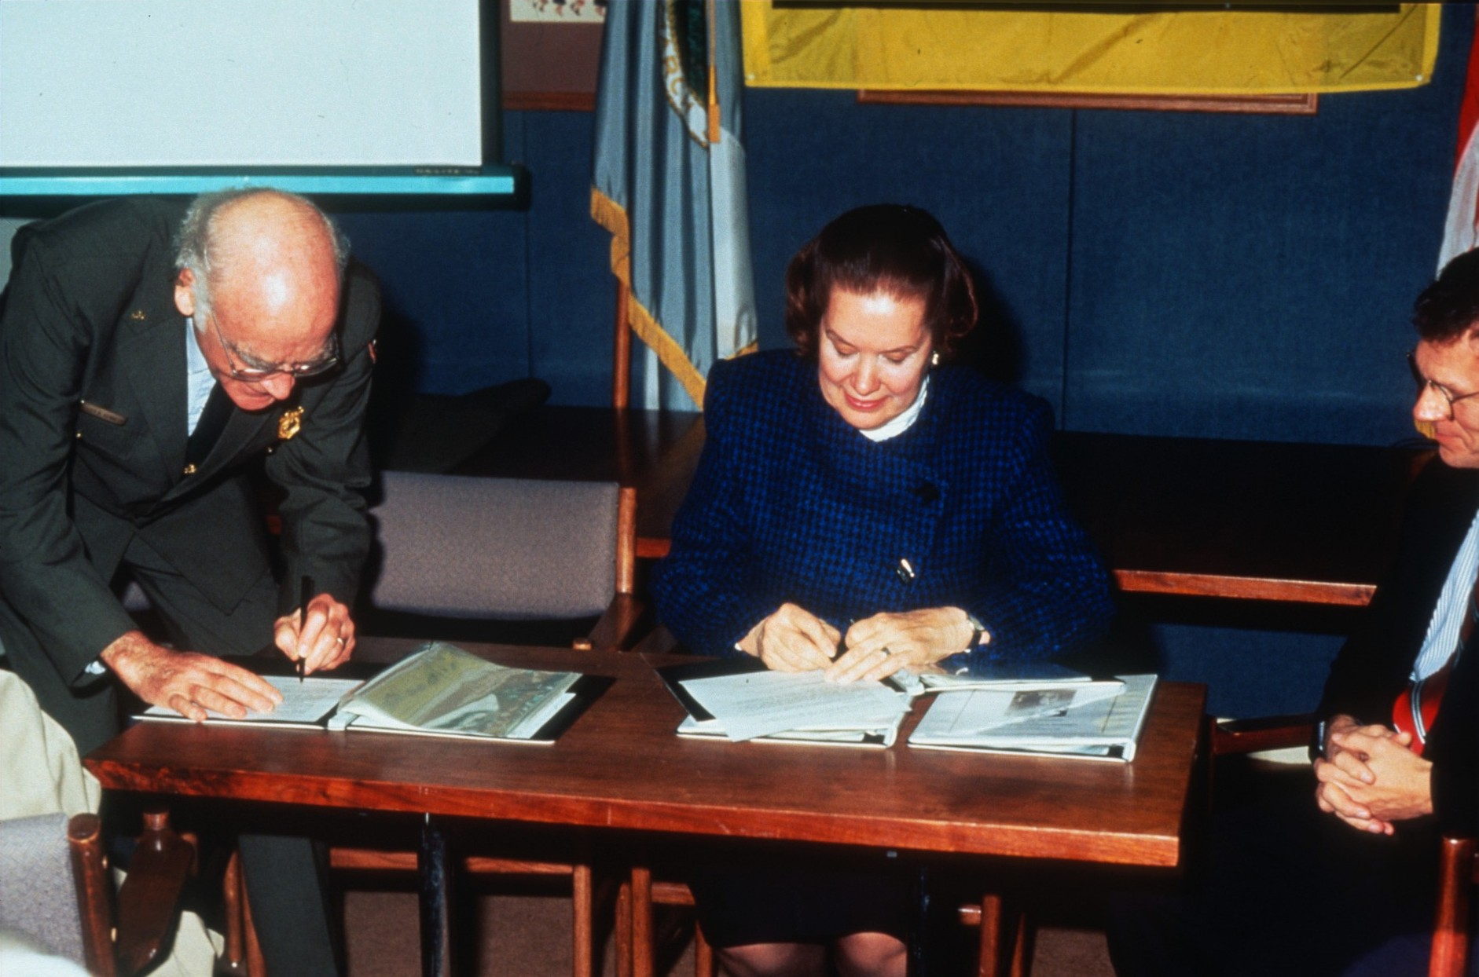
Notes:
…the National Speleological Society joins the National Park Service in the signing of a Memorandum of Understanding to encourage the management, scientific study, and protection of caves and cave resources on park lands. (Photo: Color – Signing ceremony for the NSS/NPS MOU in Washington, DC on 2 December 1993. The document (3 copies) was signed by Roger G. Kennedy, Director of the NPS, Jeanne Gurnee, President of the NSS, and Senator Tom Daschle of South Dakota, co-author of the National Cave Resources Protection Act of 1988.)

Slide 32
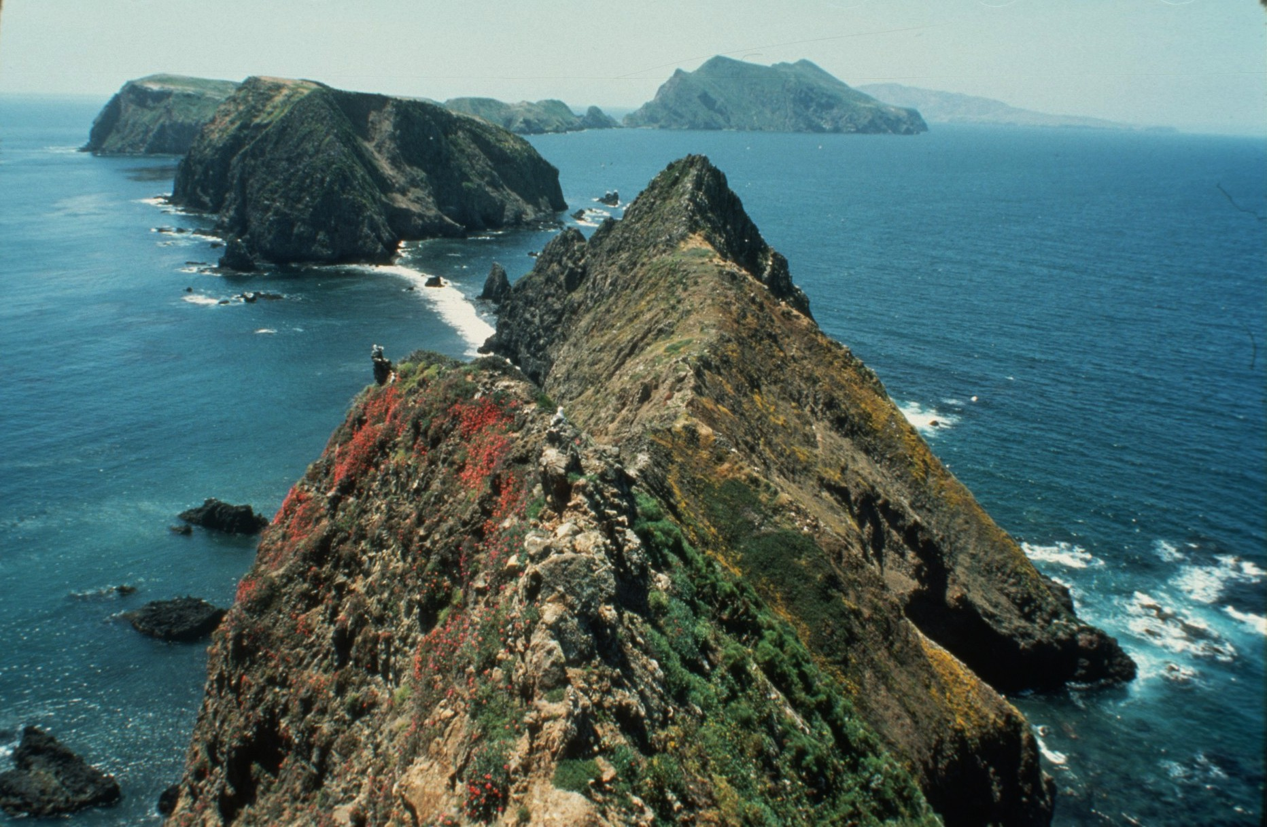
Notes:
From sea to shining sea… (Photo: Bunnell/Color – View of Channel Islands NP)

Slide 33
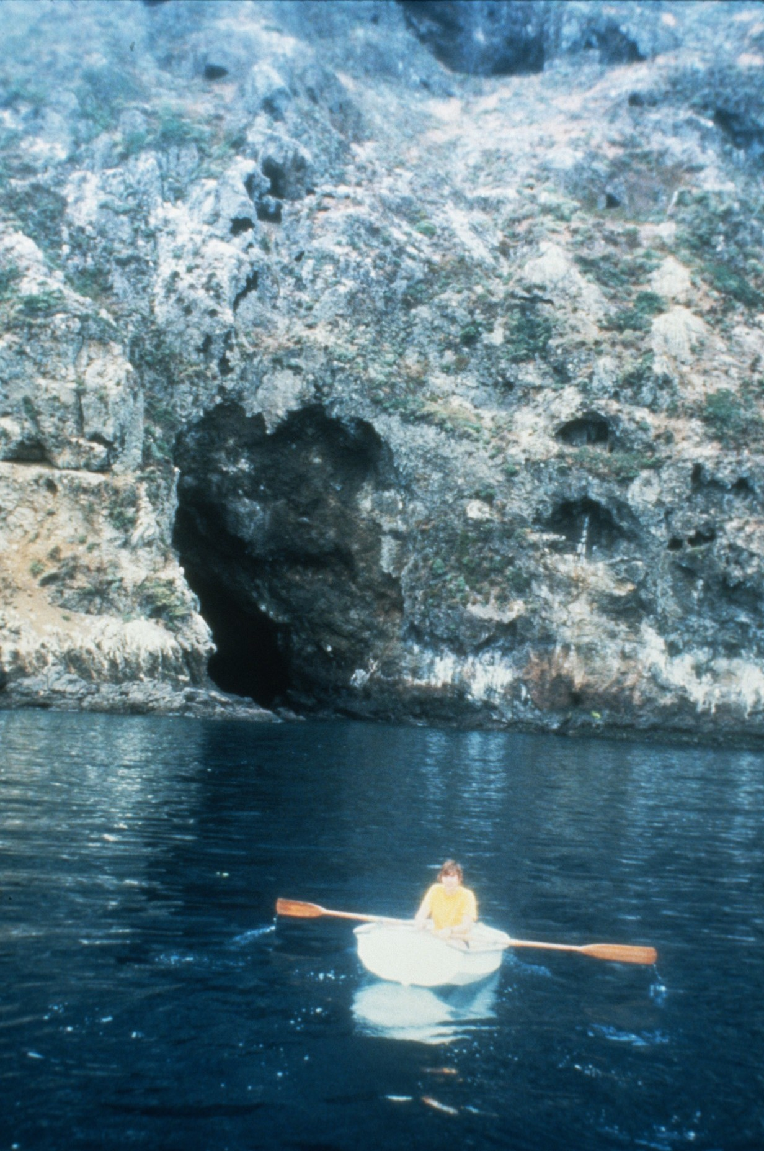
Notes:
…these cave resources in the national park systems are protected… (Photo: NPS/Color – View of cavers, in a small boat, entering Frenchy’s cave in Channel Islands NP))

Slide 34
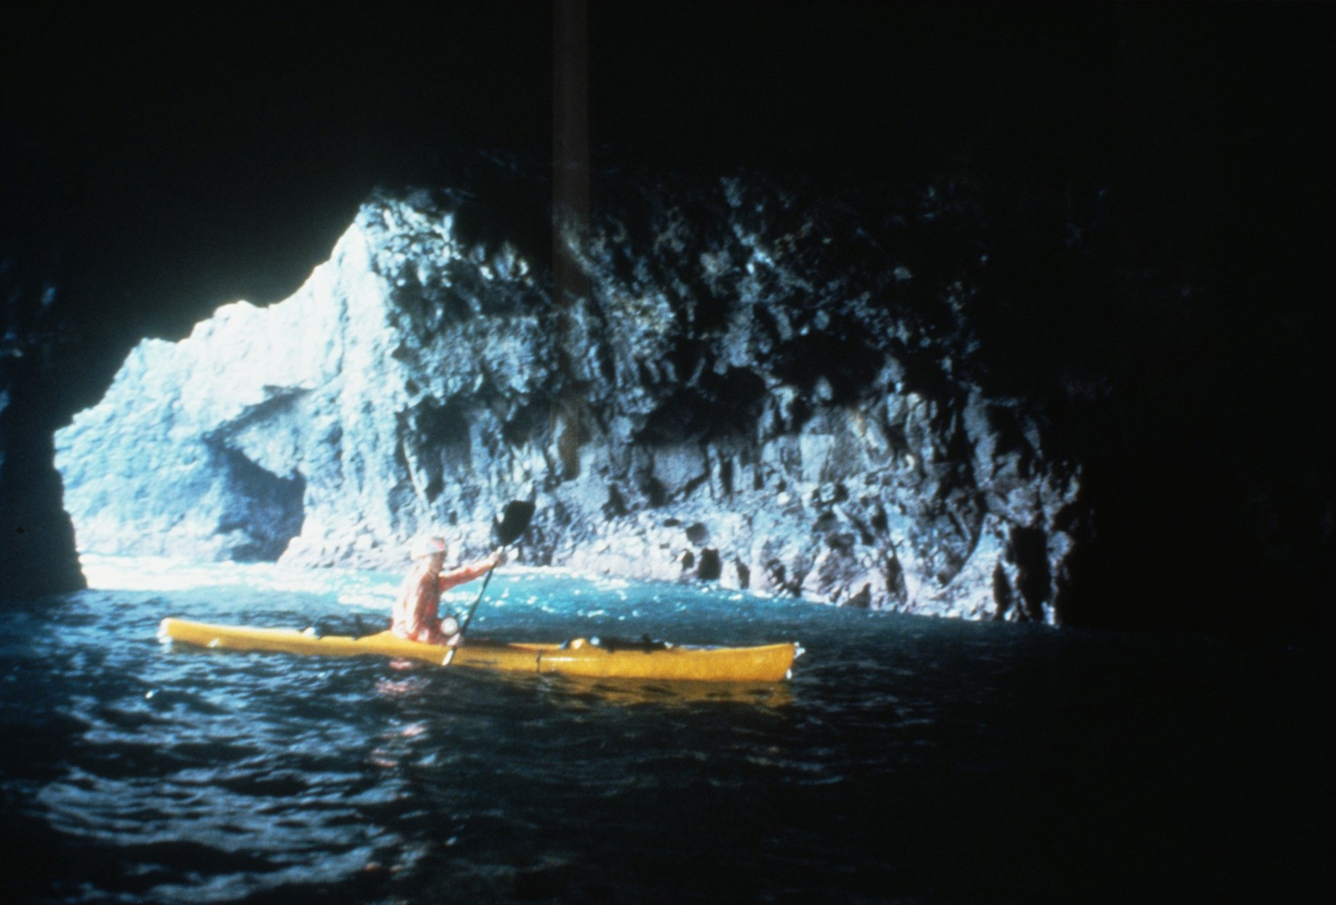
Notes:
Channel Islands National Park, CA: A large chamber in one of the caves (photograph by Dave Bunnell).

Slide 35
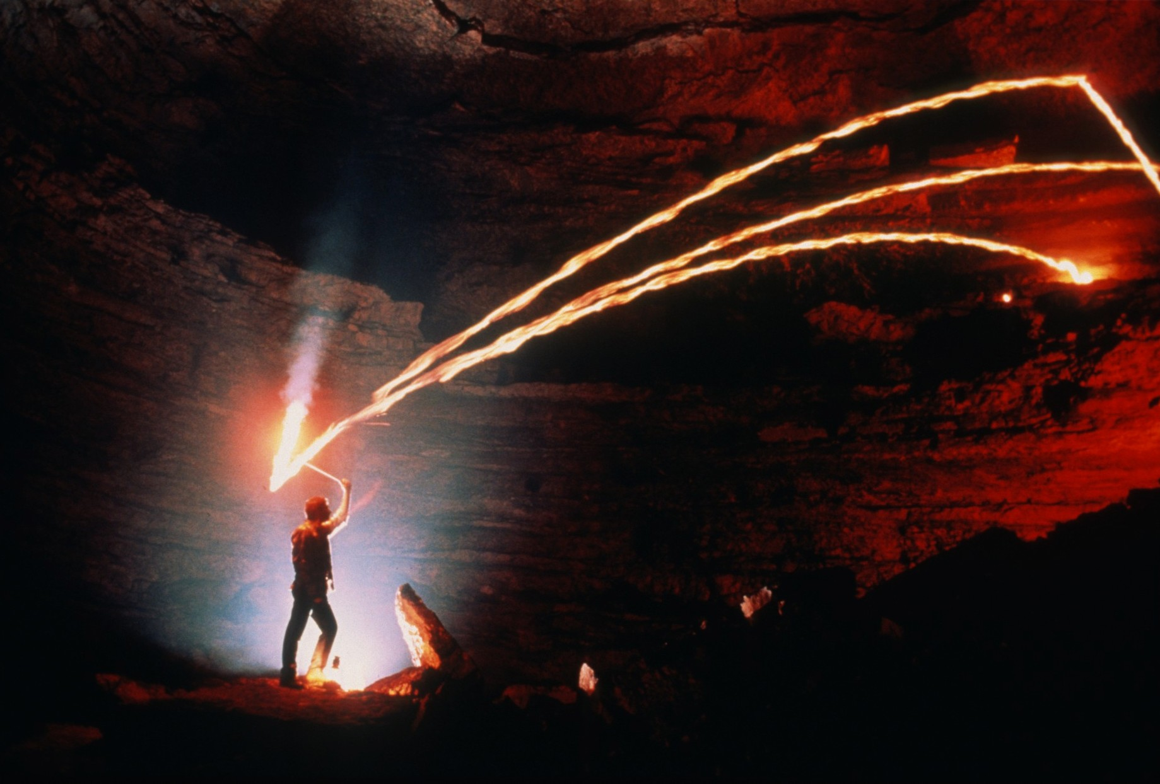
Notes:
Mammoth Cave National Park, KY: Tour guide re-enacting the throwing of kerosene torches in Mammoth Cave (photograph by Chip Clark).

Slide 36
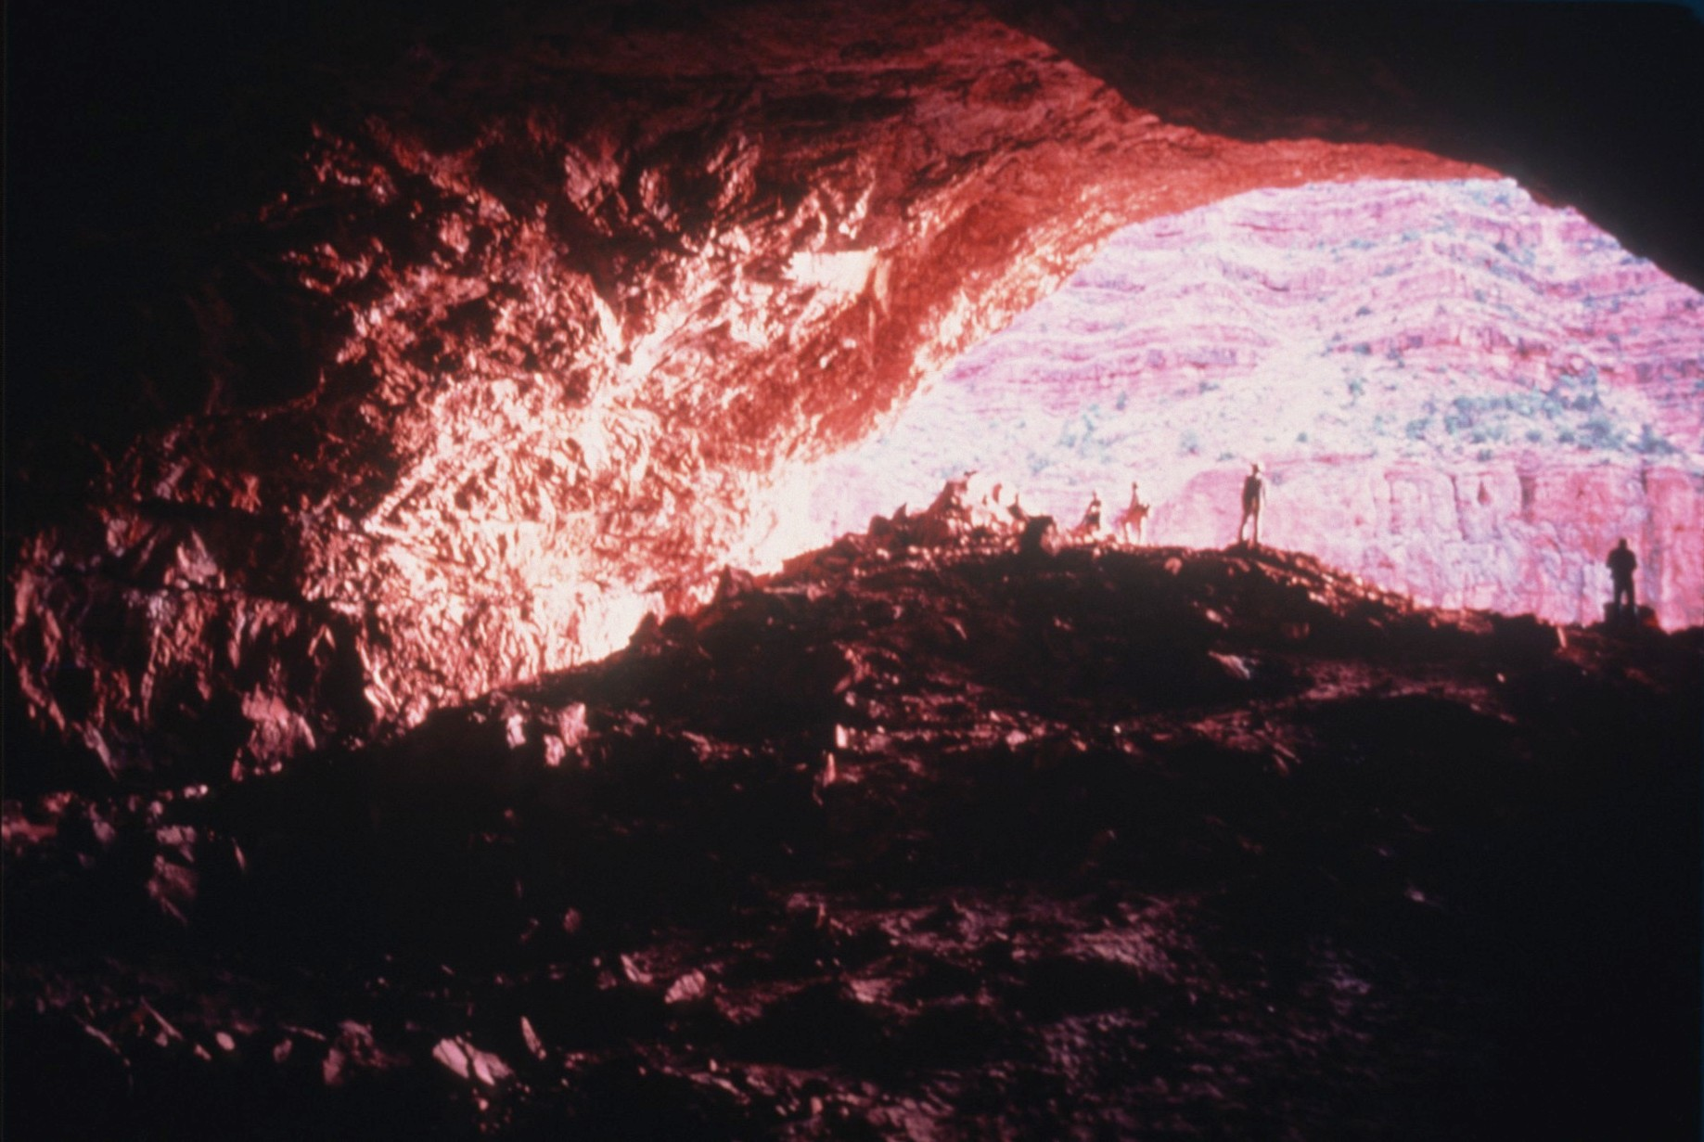
Notes:
Grand Canyon National Park, AZ: Looking out through the large broad entrance to Tse’an Bida Cave, formed in the massive Redwall Limestone (photograph by Ann & Peter Bosted).

Slide 37
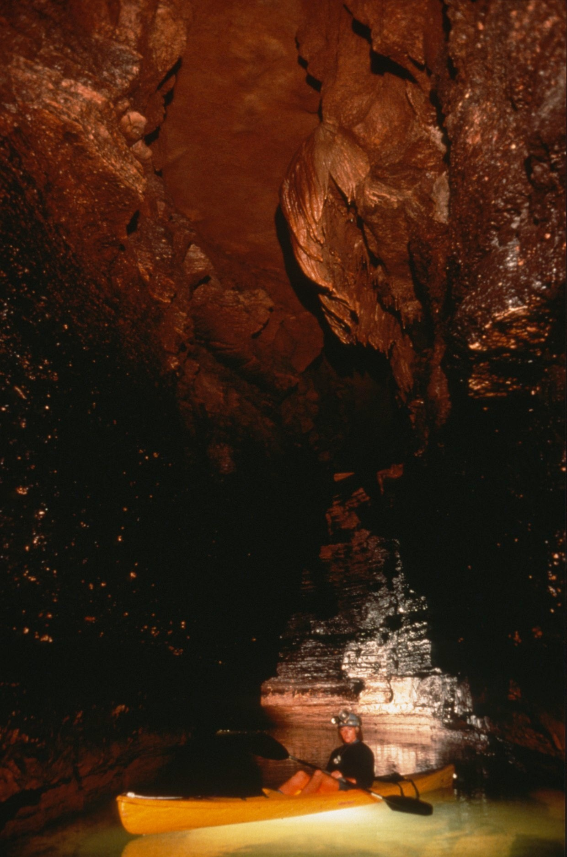
Notes:
Grand Canyon National Park, AZ: Exploring in a rubber raft in Tapeats Cave (photograph by Dave Bunnell).

Slide 38
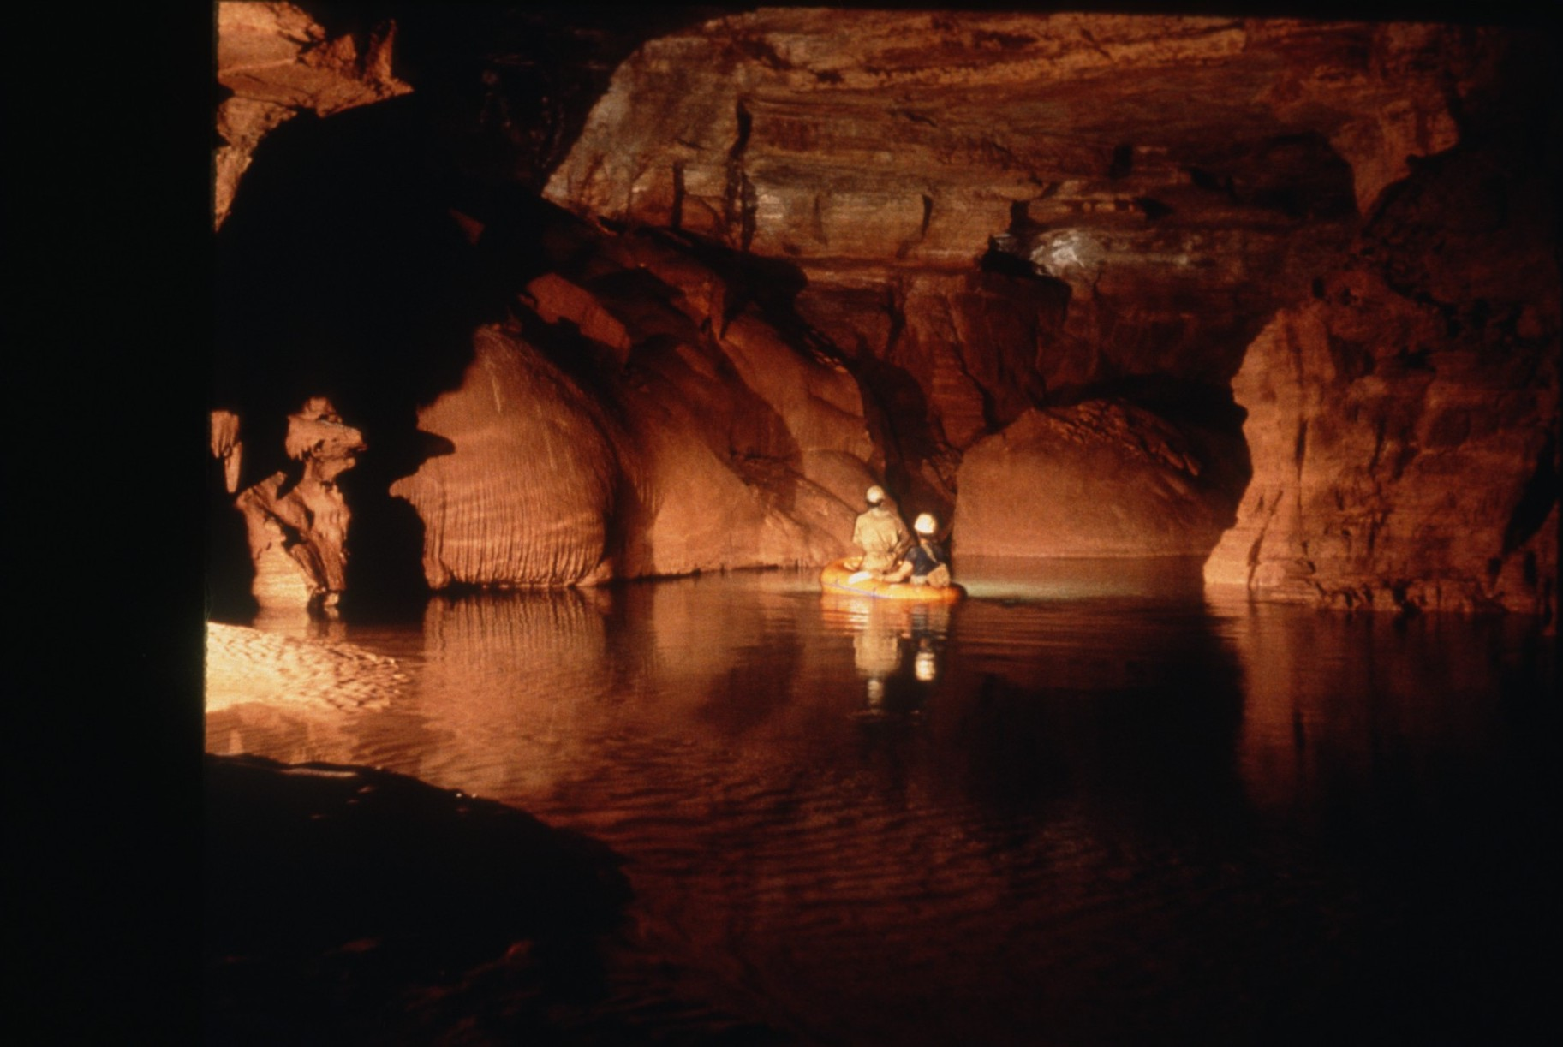
Notes:
Grand Canyon National Park, AZ: Rafting in Tapeats Cave (photograph by Ann & Peter Bosted).

Slide 39
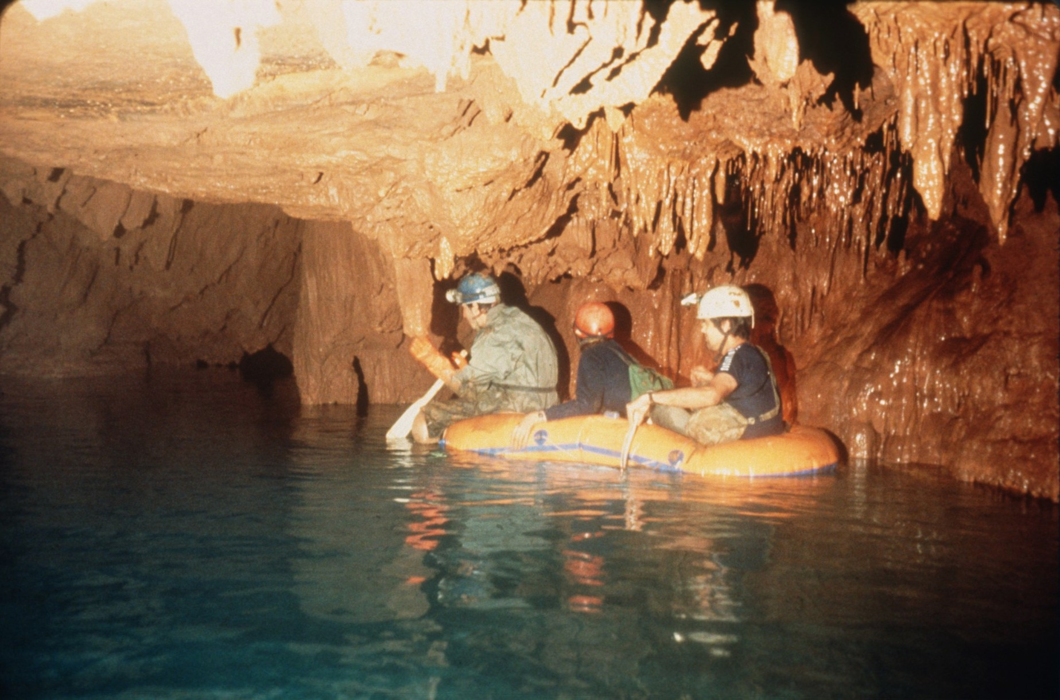
Notes:
Grand Canyon National Park, AZ: Three explorers in a raft in Tapeats Cave (photograph by Ann & Peter Bosted).

Slide 40
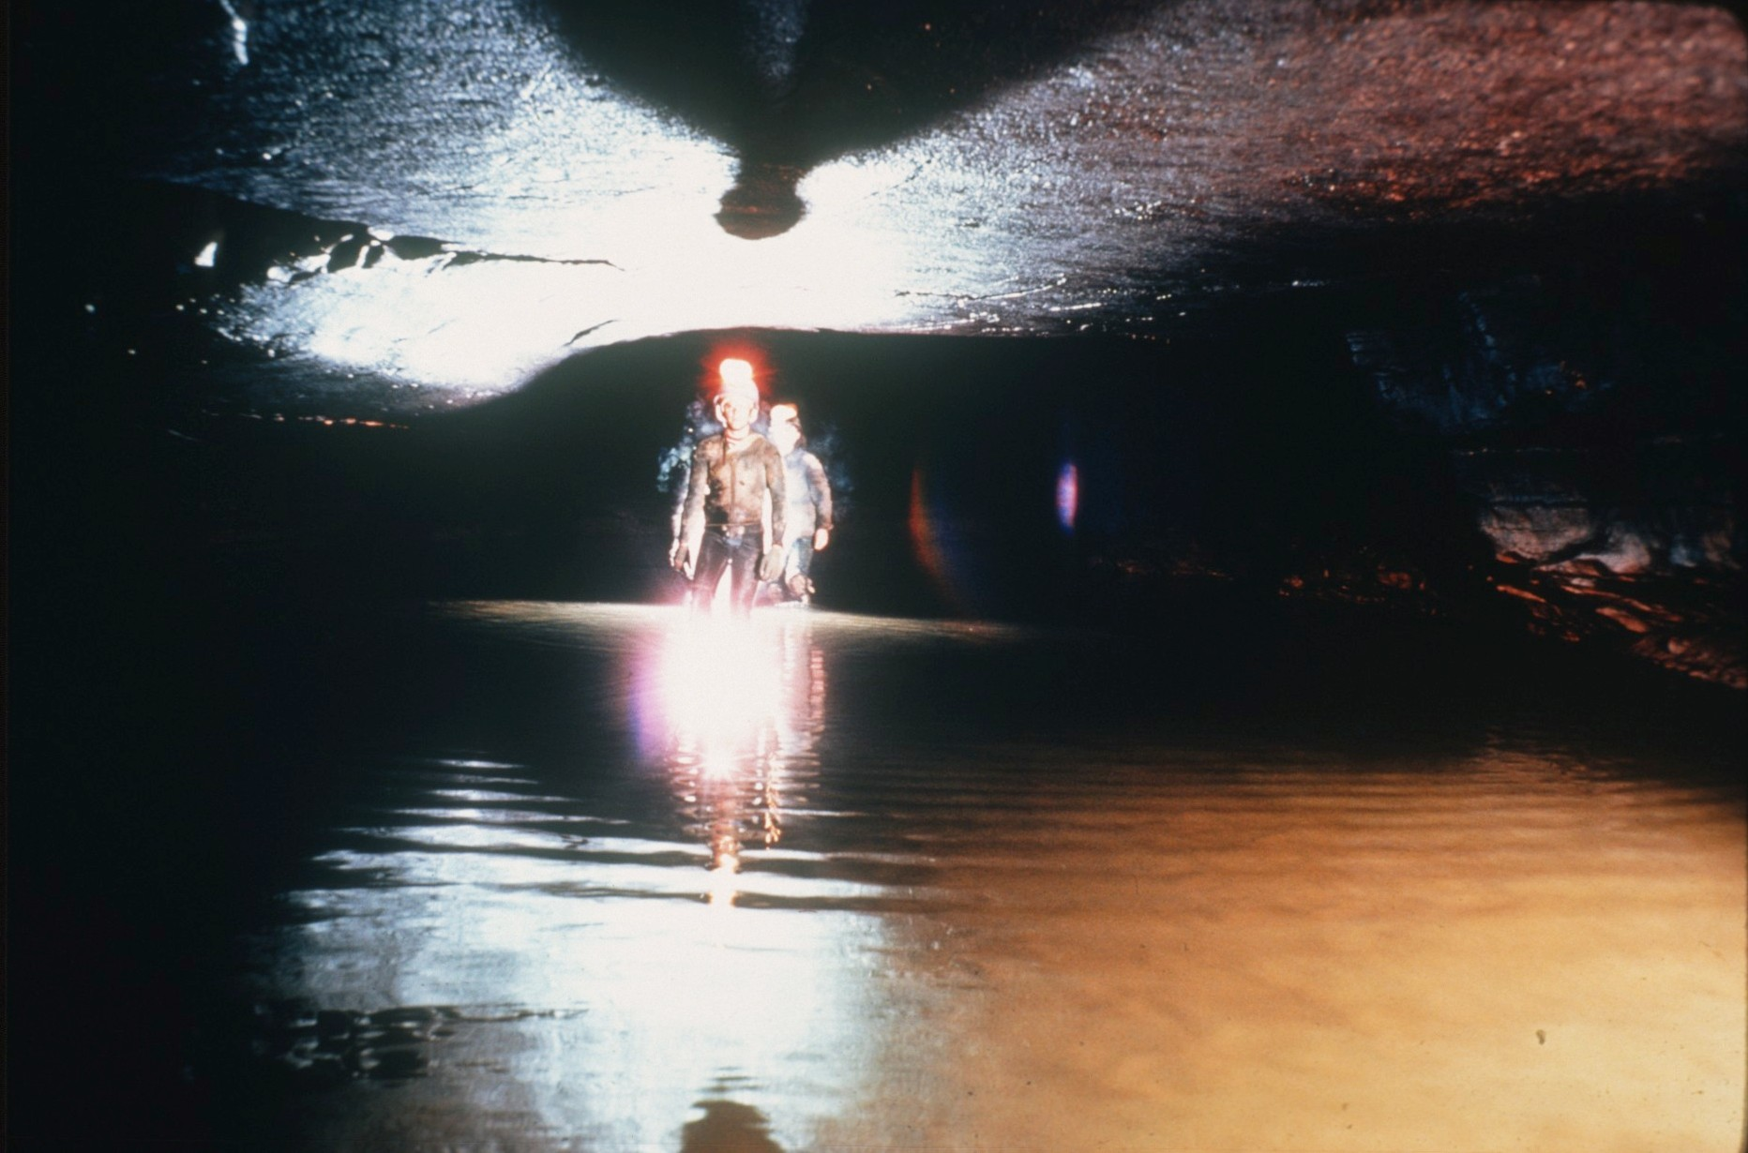
Notes:
Mammoth Cave National Park, KY: Logsdon River in the Mammoth Cave System, connecting Roppel and Proctor Caves (photograph by Arthur N. Palmer).

Slide 41
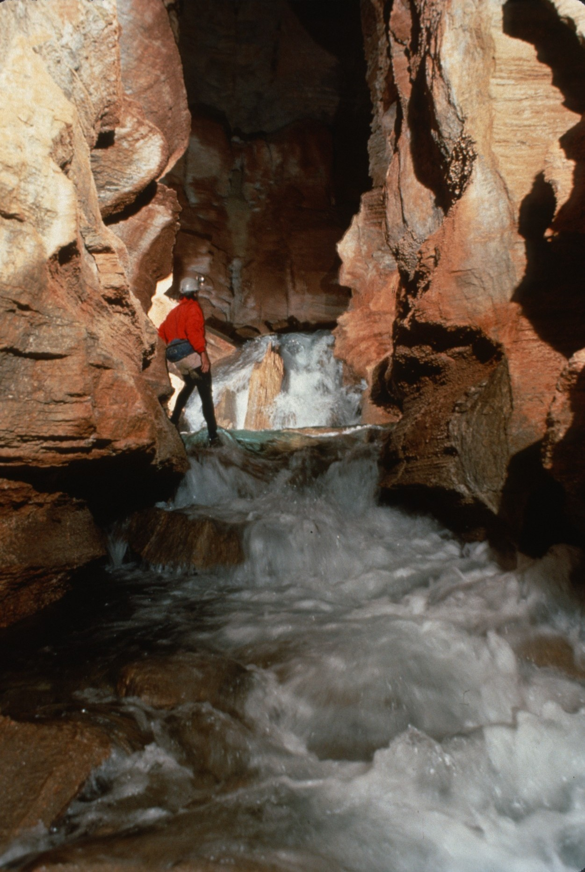
Notes:
Grand Canyon National Park, AZ: Waterfalls along in the high-discharge stream in Thunder River Cave (photograph by Dave Bunnell).

Slide 42
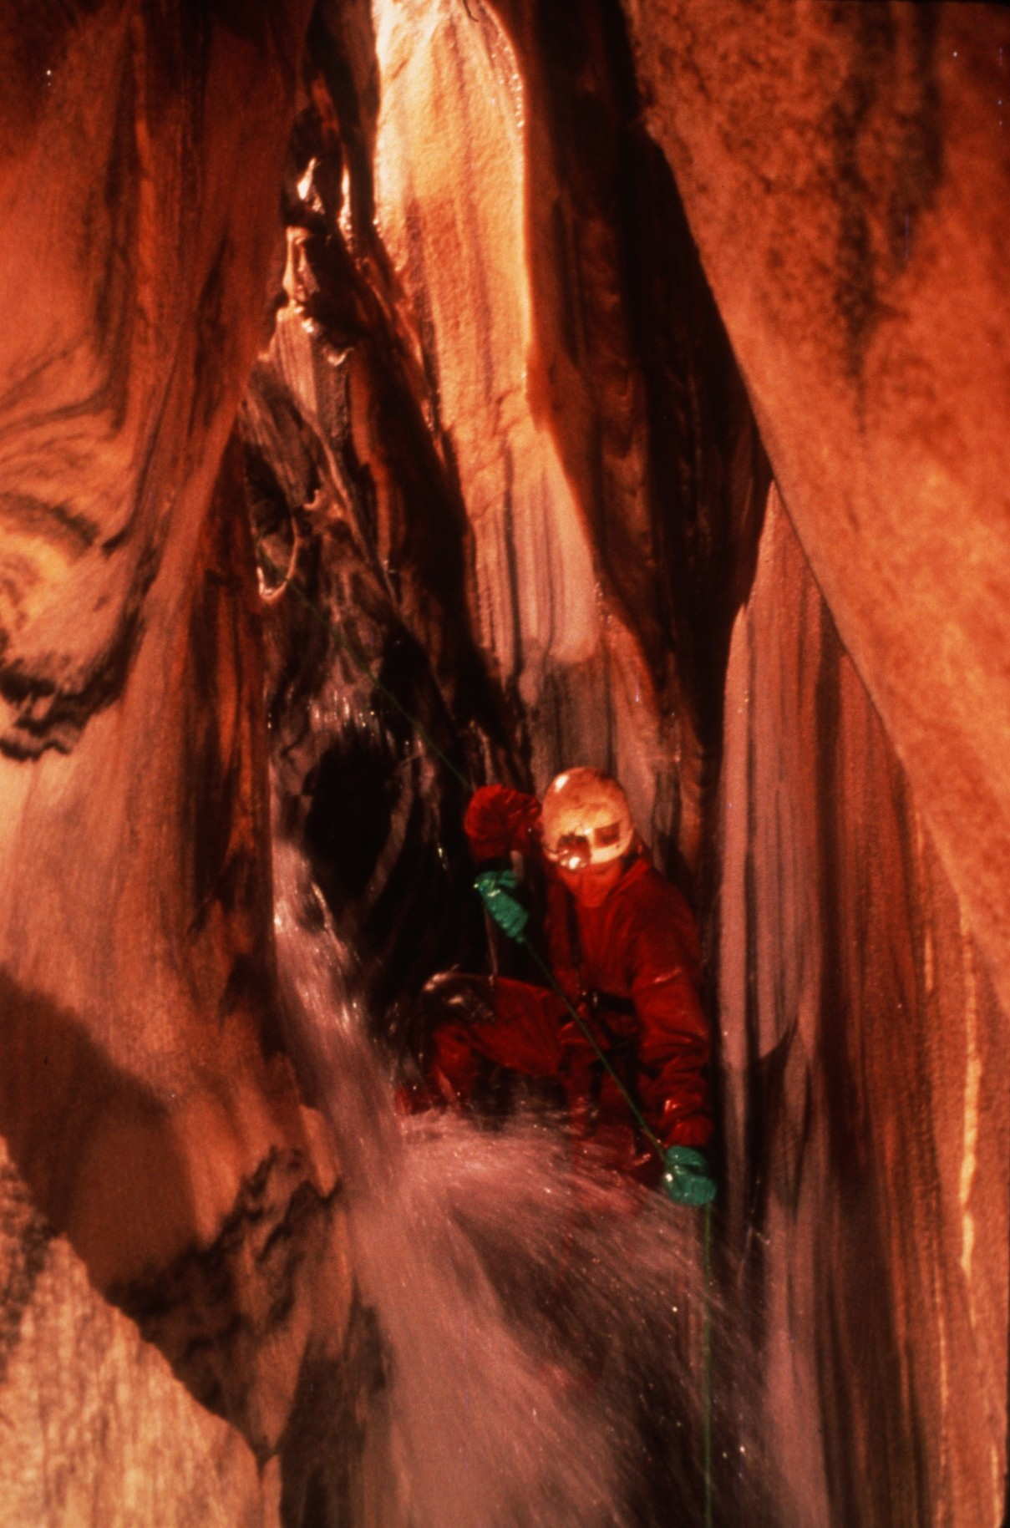
Notes:
Kings Canyon National Park, CA: Stream passage in Lilburn Cave (photograph by Ann & Peter Bosted).

Slide 43
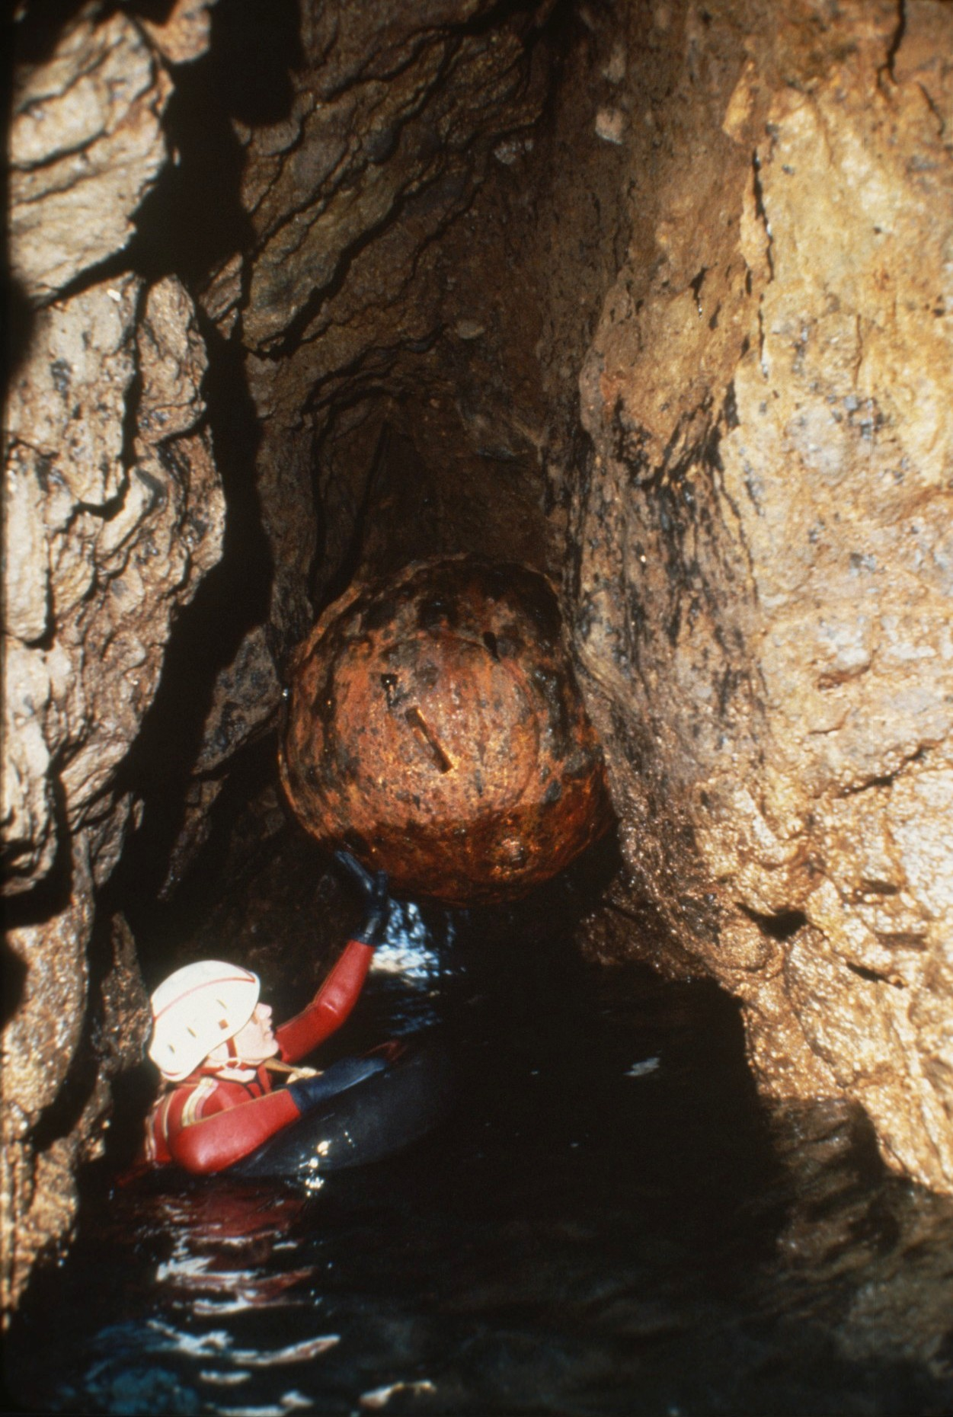
Notes:
Channel Islands National Park, CA: A strange round object, perhaps a float, in one of the sea caves (photograph by Dave Bunnell).

Slide 44
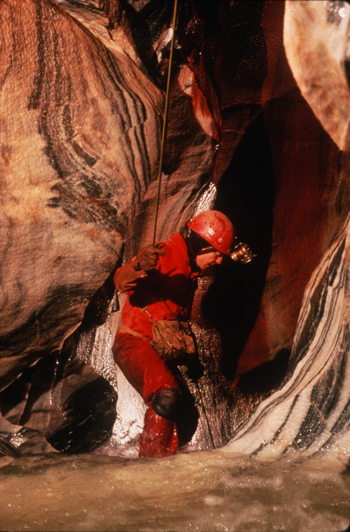
Notes:
Kings Canyon National Park, CA: Peggy Palmer climbing in Lilburn Cave (photograph by Ann & Peter Bosted).

Slide 45
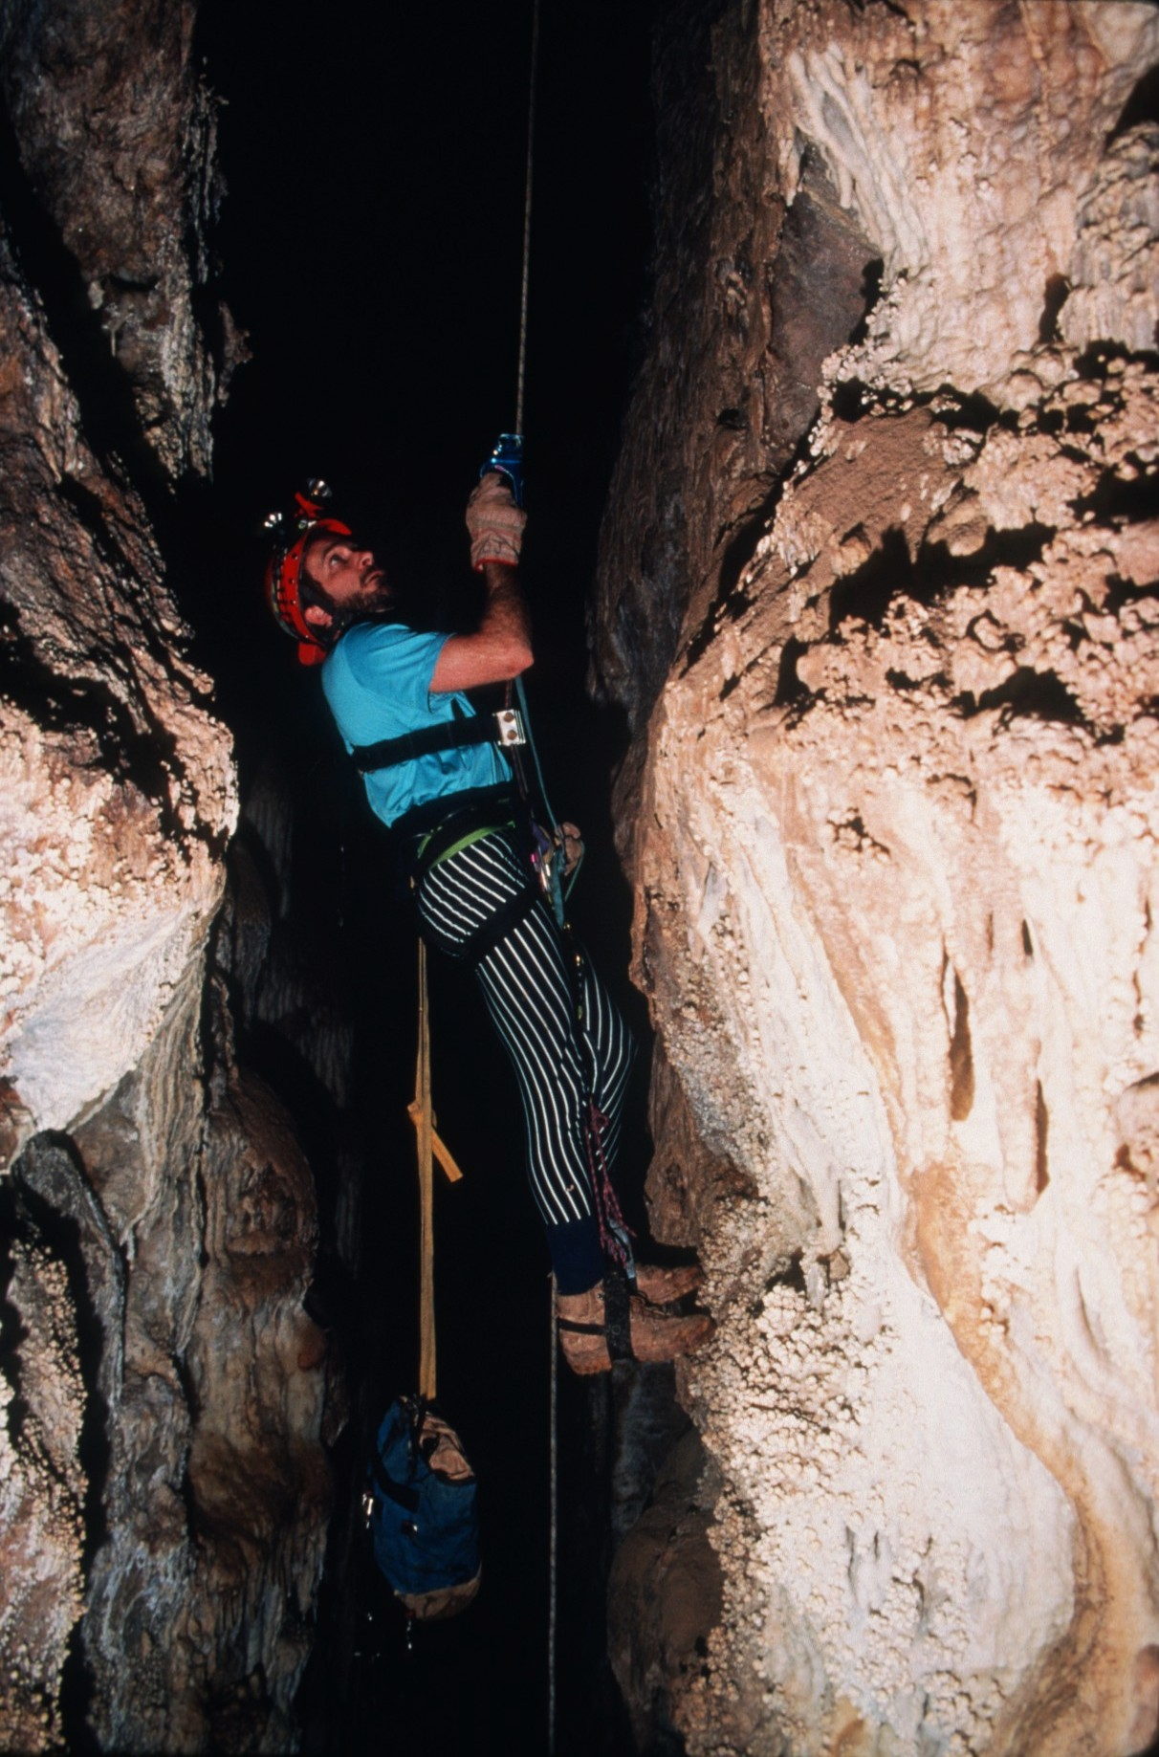
Notes:
Carlsbad Caverns National Park, NM: David Jones midway up ascent into Chocolate High section of Carlsbad Caverns (photograph by Peter Jones).

Slide 46
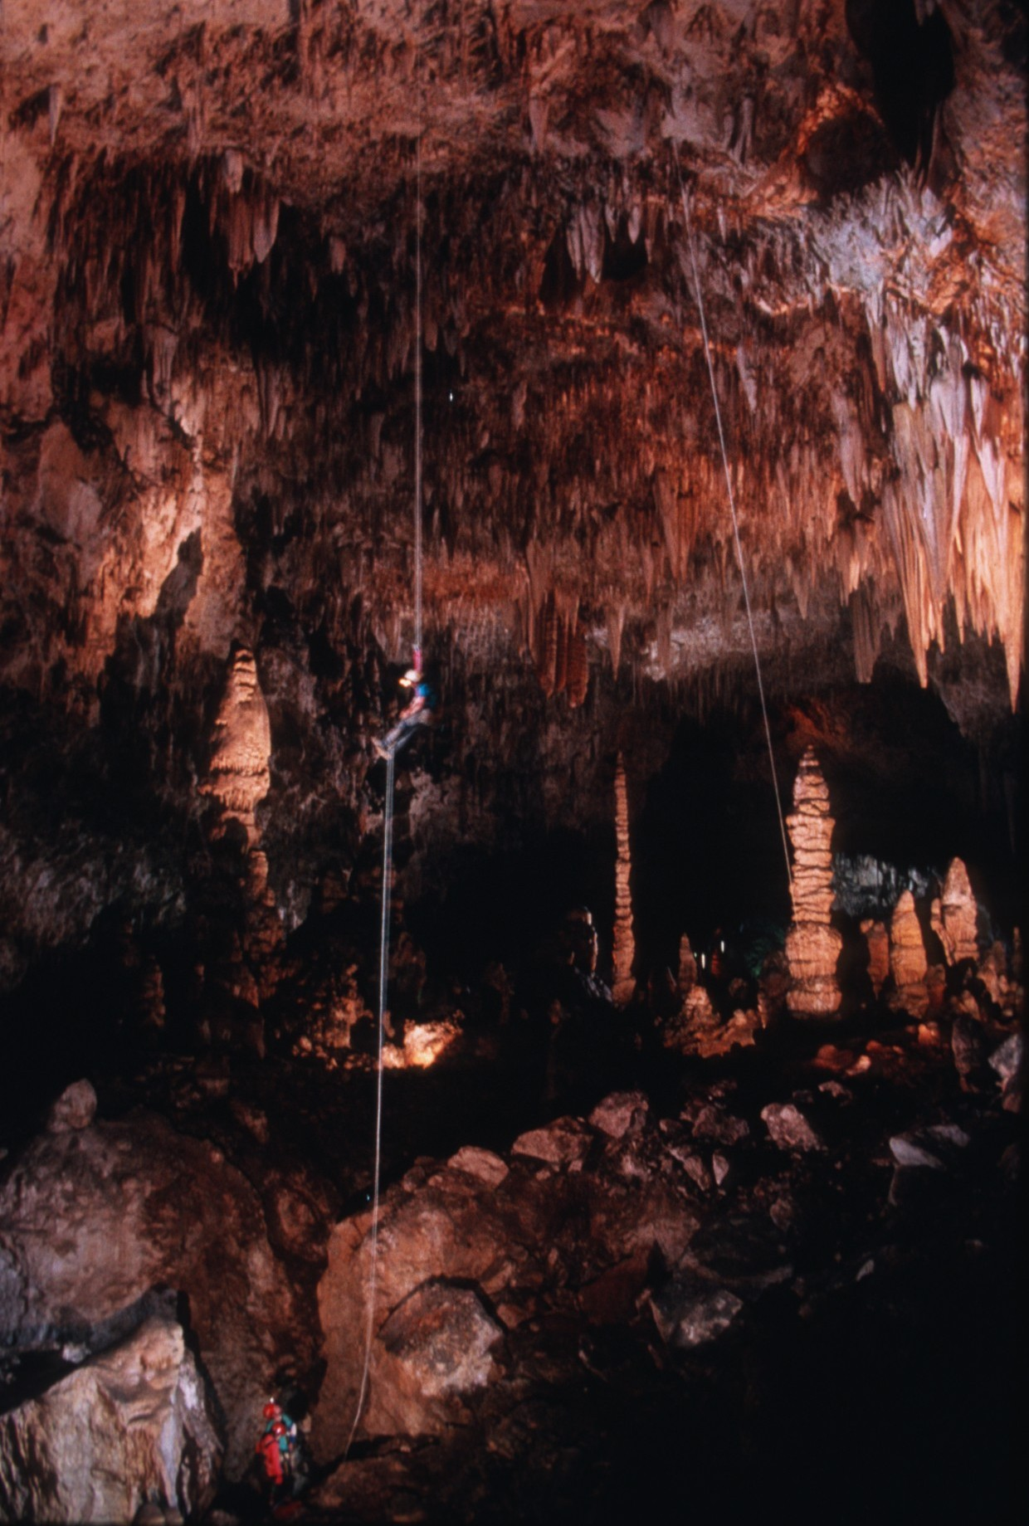
Notes:
Carlsbad Caverns National Park, NM: Caver ascending into Spirit World above Top of the Cross in Carlsbad Caverns (photograph by Peter Jones, lighting by Tom Zannes).

Slide 47
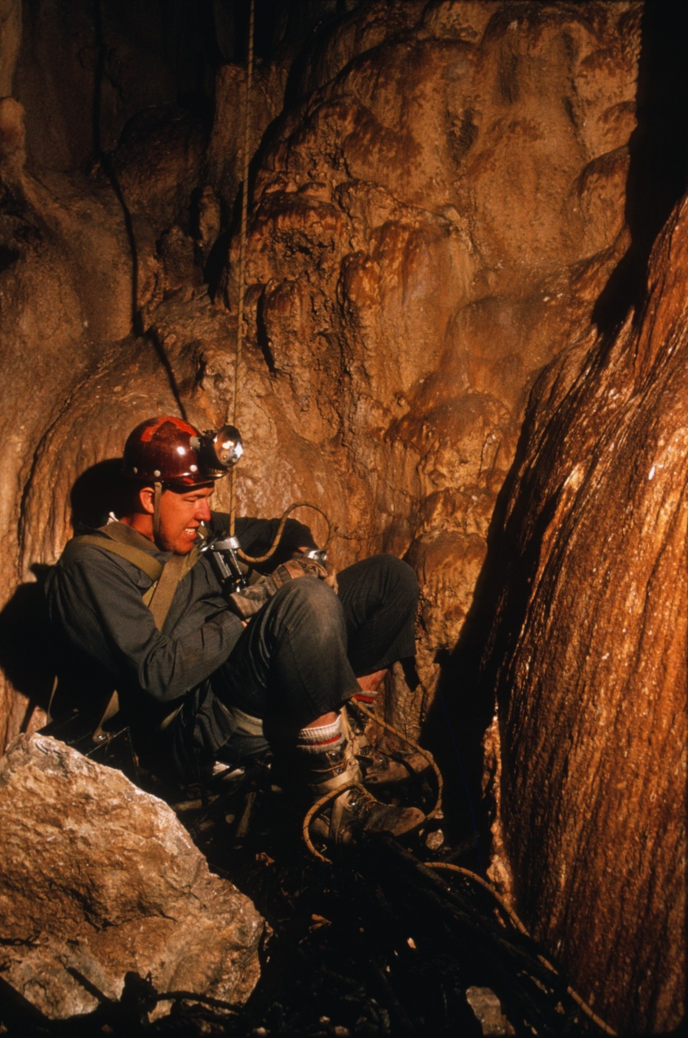
Notes:
Guadalupe Mountains National Park, TX: Tom Meador preparing to ascend a 140-foot pit in Hunters Well (photograph by Peter Jones).

Slide 48
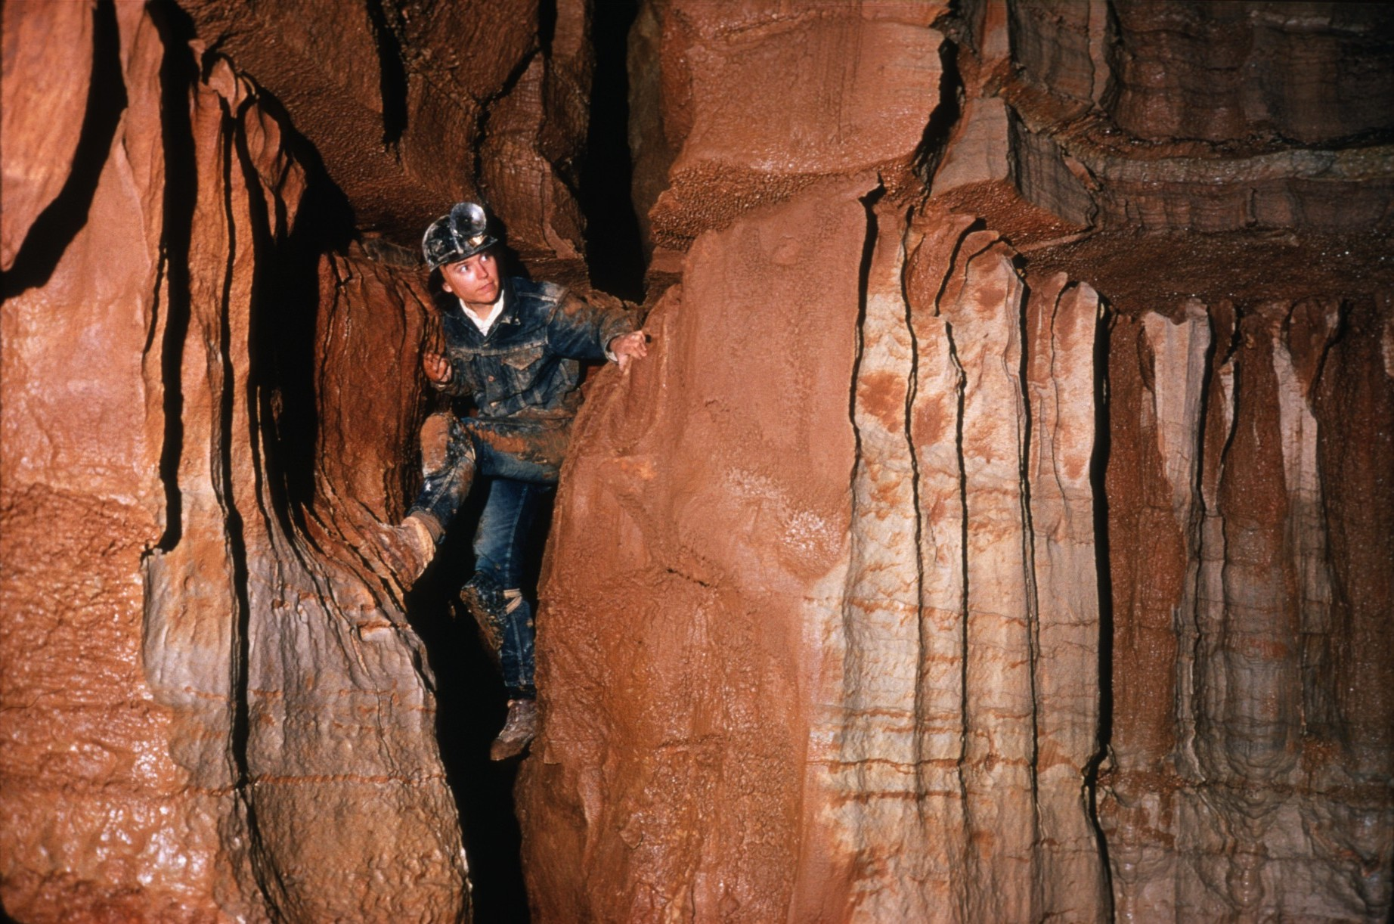
Notes:
Mammoth Cave National Park, KY: Peg Palmer in a typical canyon passage leading from a vertical shaft in the Crystal Cave section of the Mammoth Cave System (photograph by Arthur N. Palmer).

Slide 49
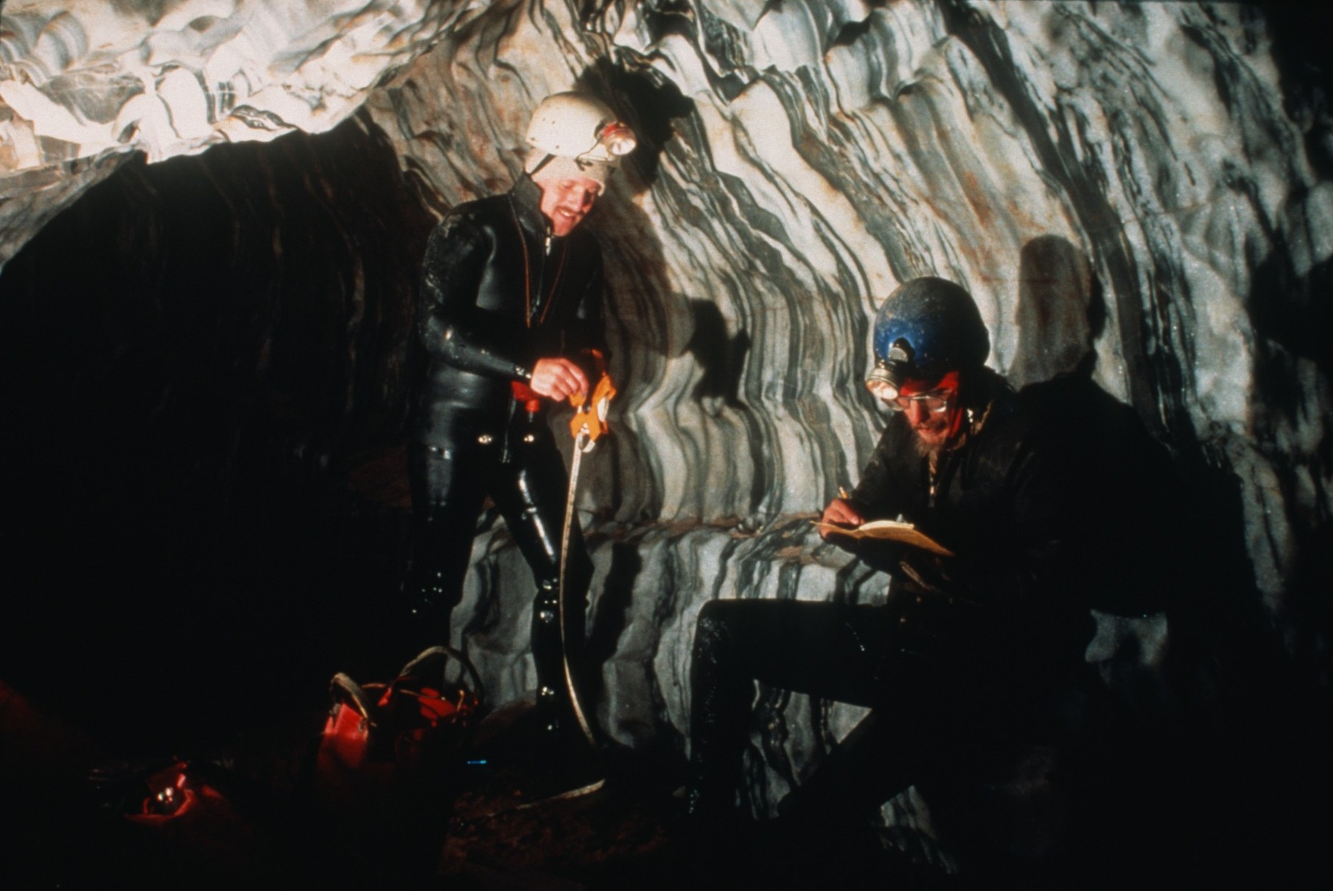
Notes:
Kings Canyon National Park, CA: Surveying passages in Lilburn Cave (photograph by Ann & Peter Bosted).

Slide 50
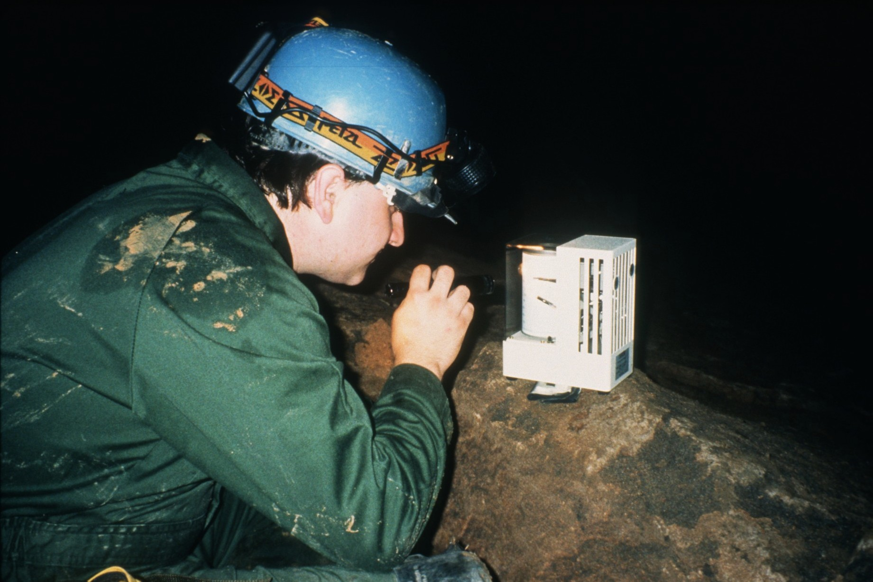
Notes:
Russell Cave National Monument, AL: Recording meteorological data in Russell Cave (photograph by Horton H. Hobbs, III).

Slide 51
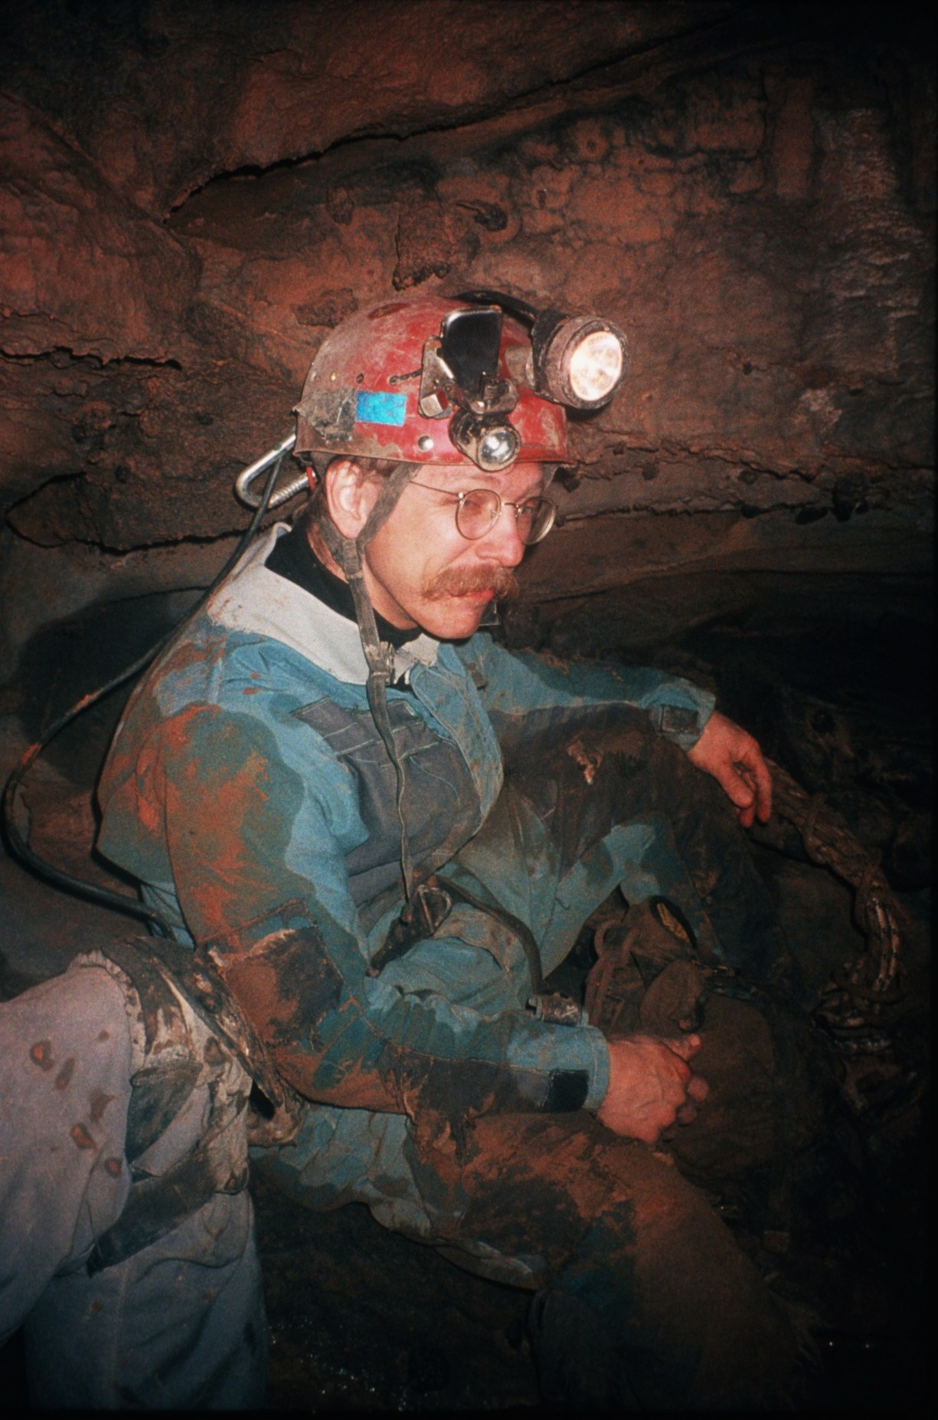
Notes:
Carlsbad Caverns National Park, NM: A tired caver in Spider Cave (photograph by Horton H. Hobbs, III).

Slide 52
Notes:
Mammoth Cave National Park, KY: A visit to the master trunk passage of Lee Cave. Among those in the party were Gordon and Judy Smith, discovers of Lee Cave (at left), Dr. Alfred Bögli of Switzerland, Burnell Ehman, and Roger Brucker (photograph by Ernst H. Kastning).

Slide 53
Notes:
Russell Cave National Monument, AL: Three cavers looking for invertebrate fauna in a pool in Russell Cave (photograph by Horton H. Hobbs, III).

Slide 54
Notes:
Russell Cave National Monument, AL: Searching for terrestrial cave biota in Russell Cave (photograph by Horton H. Hobbs, III).

Slide 55
Notes:
Mammoth Cave National Park, KY: Beetle (Nephanops) in Mammoth Cave (photograph by Chip Clark).

Slide 56
Notes:
Mammoth Cave National Park, KY: Blind crayfish (Orconectes) in Mammoth Cave (photograph by Chip Clark).

Slide 57
Notes:
Mammoth Cave National Park, KY: Isopod in Mammoth Cave (photograph by Chip Clark).

Slide 58
Notes:
Mammoth Cave National Park, KY: Blind fish (Tephlycthes) in Mammoth Cave (photograph by Chip Clark).

Slide 59
Notes:
Mammoth Cave National Park, KY: Amphipod in Mammoth Cave (photograph by Chip Clark).

Slide 60
Notes:
Mammoth Cave National Park, KY: Cave cricket (Hadonoecus subterraneus) in Mammoth Cave (photograph by Chip Clark).

Slide 61
Notes:
Jewel Cave National Monument, SD: Leaping Lunar Spiders, and unusual formation in Jewel Cave (photograph by John Scheltens).

Slide 62
Notes:
Wind Cave National Park, SD: Boxwork consisting of calcite veins projecting from weathered bedrock walls in Wind Cave (photograph by Arthur N. Palmer).

Slide 63
Notes:
Wind Cave National Park, SD: Frostwork in Wind Cave (photograph by John Scheltens).

Slide 64
Notes:
Wind Cave National Park, SD: Aragonite needles on popcorn in Wind Cave (width of view is about six inches) (photograph by Arthur N. Palmer).

Slide 65
Notes:
Carlsbad Caverns National Park, NM: An aragonite bush on the floor of Lechuguilla Cave (photograph by Kevin Downey).

Slide 66
Notes:
Carlsbad Caverns National Park, NM: Another aragonite bush surrounded by white encrusted walls in Lechuguilla Cave (photograph by Kevin Downey).

Slide 67
Notes:
Carlsbad Caverns National Park, NM: Large passage of oval cross section in Lechuguilla Cave (photograph by Kevin Downey).

Slide 68
Notes:
Carlsbad Caverns National Park, NM: A “forest” of tall formations in Wen Cave (photograph by Ann & Peter Bosted).

Slide 69
Notes:
Grand Canyon National Park, AZ: Room with large formation in Cave of the Domes (photograph by Ann & Peter Bosted).

Slide 70
Notes:
Carlsbad Caverns National Park, NM: Very tall stalagmites and columns in Ogle Cave (photograph by Ann & Peter Bosted).

Slide 71
Notes:
Mammoth Cave National Park, KY: Crystal Lake in Mammoth Cave (photograph by Chip Clark).

Slide 72
Notes:
Wind Cave National Park, SD: Caver straddling a pool in Wind Cave (photograph by John Scheltens).

Slide 73
Notes:
Carlsbad Caverns National Park, NM: A former pool, now dry, in Lechuguilla Cave. This room has orange-colored walls (photograph by Kevin Downey).

Slide 74
Notes:
Carlsbad Caverns National Park, NM: Lake of the Clouds, the lowest point in Carlsbad Caverns (photograph by Ann & Peter Bosted).

Slide 75
Notes:
Carlsbad Caverns National Park, NM: Another view of Lake of the Clouds, Carlsbad Caverns (photograph by Peter Jones)

Slide 76
Notes:
Carlsbad Caverns National Park, NM: Large lilly-pad formation pool in Lechuguilla Cave (photograph by Dave Bunnell).

Slide 77
Notes:
Carlsbad Caverns National Park, NM: View of encrusted stalactites in the Vesuvius Room of Lechuguilla Cave (photograph by Dave Bunnell).

Slide 78
Notes:
Carlsbad Caverns National Park, NM: Room with formations in Lechuguilla Cave (photograph by Kevin Downey).

Slide 79
Notes:
Wind Cave National Park, SD: Room with walls, floor, and ceiling encrusted with white crystals of gypsum in Wind Cave (photograph by John Scheltens).

Slide 80
Notes:
Carlsbad Caverns National Park, NM: Entrance to Carlsbad Caverns through which thousands of visitors enter the cave each year (photograph by Ernst H. Kastning).

Slide 81
Notes:
Walnut Canyon National Monument, AZ: One of the many small cliff dwellings within rock shelters (photograph by Ernst H. Kastning).

Slide 82
Notes:
Mesa Verde National Park, CO: Cliff Palace, the largest Anasazi cliff dwelling in the United States (photograph by Carolyn Cronk).

Slide 83
Notes:
Scotts Bluff National Monument, NE: “Jabba the Hutt,” a face in the rock formed by the Aeolian erosion in sandstone. Several small shelter caves are located nearby (photograph by Ernst H. Kastning).

Slide 84
Notes:
Natural Bridges National Monument, UT: One of several large bridges in sandstone shown after a winter snowfall (photograph by Ernst H. Kastning).

Slide 85
Notes:
Montezuma Castle National Monument, AZ: Montezuma Castle, a singular Anasazi dwelling, is located high in a sandstone cliff (photograph by Ernst Kastning).

Slide 86
Notes:
Bandelier National Monument, NM: A view from Ceremonial Cave, an Anasazi cliff dwelling (photograph by Carolyn Cronk).

Slide 87
Notes:
Death Valley National Monument, CA: Furnace Cave, a suffusion cave and the lowest known cave in the United States, at 170 feet below sea level (photograph by Ernst H. Kastning).

Slide 88
Notes:
Russell Cave National Monument, AL: Passage in Russell Cave (photograph by Horton H. Hobbs, III).

Slide 89
Notes:
Wind Cave National Park, SD: Backlit arched passage in Wind Cave (photograph by John Scheltens).

Slide 90
Notes:
Theodore Roosevelt National Park, ND: Looking out from the entrance of Suffosion Cave, a forty-foot long cave formed by piping in a badlands topography (photograph by Ernst H. Kastning).

Slide 91
Notes:
Pinnacles National Monument, CA: A series of talus caves lies among the weathered boulders that have become lodged in this valley (photograph by Ernest H. Kastning).

Slide 92
Notes:
Guadalupe Mountains National Park, TX: Rappelling into the entrance of Hunters Well (photograph by Peter Jones).

Slide 93
Notes:
Carlsbad Caverns National Park, NM: Donald Davis about to ascent into the Chocolate High section off the NM Room in Carlsbad Caverns (photograph by Peter Jones).

Slide 94
Notes:
Carlsbad Caverns National Park, NM: The Christmas Tree in a large room in Christmas Tree Cave (photograph by Peter Jones).

Slide 95
Notes:
Great Smokey Mountains National Park, TN: Alum Cave, a large over-hanging shelter cave on a trail to the summit of Mount LaConte (photograph by Ernst H. Kastning).

Slide 96
Notes:
Mammoth Cave National Park, KY: A karst window within the Mammoth Cave drainage basin. Here, a stream enters the bottom of the sinkhole, flows across the bottom and reenters the ground on the other side (photograph by Ernst H. Kastning).

Slide 97
Notes:
Russell Cave National Monument, AL: Lower main entrance with scream, Russell Cave (photograph by Horton H. Hobbs, III).

Slide 98
Notes:
Sequoia National Park, CA: Rimstone pools in Sequoia Crystal Cave (photograph by Ann & Peter Bosted).

Slide 99
Notes:
Grand Canyon National Park, AZ: Convoluted formations in Tse’an Bida Cave (view is 24 inches from top to bottom) (photograph by Ann & Peter Bosted)

Slide 100
Notes:
Grand Canyon National Park, AZ: Pocket of orange dogtooth spar in Cave of the Domes (photograph by Ann & Peter Bosted).

Slide 101
Notes:
Wind Cave National Park, SD: Mud cracks with calcite deposition in Wind Cave (photograph by John Scheltens).

Slide 102
Notes:
Mammoth Cave National Park, KY: Peeling layers of limestone in the ceiling of a passage in Crystal Cave in the Mammoth Cave system. Crystals of gypsum growing between the beds have wedge apart the strata (photograph by Ernst H. Kastning).

Slide 103
Notes:
Mammoth Cave National Park, KY: Marshall Avenue, the master trunk passage of Lee Cave near its terminus where it meets the wall of a valley on the surface (photograph by Ernst H. Kastning).

Slide 104
Notes:
Carlsbad Caverns National Park, NM: Great Wall of China, a long rimstone dam in Slaughter Canyon Cave (photograph by Ann & Peter Bosted).

Slide 105
Notes:
Carlsbad Caverns National Park, NM: Karren-like features on a floor in Lechuguilla Cave (photograph by Kevin Downey).

Slide 106
Notes:
Kings Canyon National Park, CA: Walls of banded marble in Lilburn Cave (photograph by Ann & Peter Bosted).

Slide 107
Notes:
Kings Canyon National Park, CA: A sculpted alcove in banded marble in Lilburn Cave (photograph by Dave Bunnell).

Slide 108
Notes:
Kings Canyon National Park, CA: caver negotiating a wet passage in Lilburn Cave (photograph by Ann & Peter Bosted).

Slide 109
Notes:
Wind Cave National Park, SD: Passage with breakdown in Wind Cave (photograph by John Scheltens).

Slide 110
Notes:
Carlsbad Caverns National Park, NM: Susanna Patterson viewing large helictites in Spider Cave (photograph by Peter Jones).

Slide 111
Notes:
Carlsbad Caverns National Park, NM: “Ropework” stalactites in Lechuguilla Cave (photograph by Kevin Downey).

Slide 112
Notes:
Jewel Cave National Monument, SD: Nailhead spar lining the walls in Jewel Cave (width of view about ten inches) (photograph by Arthur N. Palmer).

Slide 113
Notes:
Wind Cave National Park, SD: Popcorn and short soda-straw stalactites with water drops in Wind Cave (photograph by Arthur N. Palmer).

Slide 114
Notes:
Sequoia National Park, CA: Soda straws with water drops in Cave of the Lost Soldier (photograph by Ann & Peter Bosted).

Slide 115
Notes:
Carlsbad Caverns National Park, NM: Soda straws in Lechuguilla Cave. Tips of the stalactites were immersed in a former cave pool and calcite precipitated onto them from the pool water (photograph by Kevin Downey).

Slide 116
Notes:
Carlsbad Caverns National Park, NM: A recent white stalagmite formed on an earlier shelfstone deposit in Lechuguilla Cave (photograph by Kevin Downey).

Slide 117
Notes:
Jewel Cave National Monument, SD: Stalactites resembling bacon and clinging drops of water, Jewel Cave (photograph by Arthur N. Palmer).

Slide 118
Notes:
Jewel Cave National Monument, SD: Stalactite and stalagmite in the Formation Room on the Scenic Route in Jewel Cave. Here popcorn covers much of the wall (photograph by Arthur N. Palmer).

Slide 119
Notes:
Lava Beds National Monument, CA: Passage in Hopkins Chocolate Cave, a lava tube (photograph by Dave Bunnell).

Slide 120
Notes:
Craters of the Moon National Monument, ID: Interior of one of many lava tubes in the national monument (photograph by Ann & Peter Bosted).

Slide 121
Notes:
Lava Beds National Monument, CA: Passage A lava tube lit from the foreground (photograph by Dave Bunnell).

Slide 122
Notes:
Lava Beds National Monument, CA: A pair of lava tube passages, backlit by separate photographic flashes (photograph by Dave Bunnell).

Slide 123
Notes:
Carlsbad Caverns National Park, NM: Well-formed spherical cave pearls in Lechuguilla Cave (photograph by Kevin Downey).

Slide 124
Notes:
Carlsbad Caverns National Park, NM: Nest of cave pearls in a splash pool in Lechuguilla Cave (photograph by Dave Bunnell).

Slide 125
Notes:
Mammoth Cave National Park, KY: View down Keller Well (a 60-foot-deep vertical shaft, 8 feet in diameter) in Flint Ridge section of the Mammoth Cave System (photograph by Arthur N. Palmer).

Slide 126
Notes:
Hawaii Volcanoes National Park, HI: Passage in Thurston Lava Tube (photograph by Carolyn Cronk).

Slide 127
Notes:
Hawaii Volcanoes National Park, HI: Looking out from a fern-covered entrance to Thurston Lava Tube (photograph by Carolyn Cronk).

Slide 128
Notes:
Ozark National Scenic Riverways, MO: Big Spring, shown here, has the highest discharge of any spring in the United States. Water issuing here has been traced through this karst aquifer from as far away as over twenty miles (photograph by Ernst H. Kastning).

Slide 129
Notes:
Pictured Rocks National Lakeshore, MI: One of the many wave-carved caves along the cliffs on the southern shore of Lake Superior (photograph by Ernst H. Kastning).

Slide 130
Notes:
Carlsbad Caverns National Park, NM: A “Swiss-cheese”-like passage in Lechuguilla Cave (photograph by Kevin Downey).

Slide 131
Notes:
Carlsbad Caverns National Park, NM: A partially eroded formation in Lechuguilla Cave. Rings representing layers of growth have been exposed by erosion (photograph by Kevin Downey).

Slide 132
Notes:
Carlsbad Caverns National Park, NM: Broomstick formations in Deep Cave (photograph by Peter Jones).

Slide 133
Notes:
Carlsbad Caverns National Park, NM: Tall formations in Virgin Cave (photograph by Ann & Peter Bosted).

Slide 134
Notes:
Carlsbad Caverns National Park, NM: Large fluted formations in Ogle Cave (photograph by Dave Bunnell).

Slide 135
Notes:
Carlsbad Caverns National Park, NM: Long passage of large cross section in Ogle Cave (photograph by Dave Bunnell).

Slide 136
Notes:
Jewel Cave National Monument, SD: Passage with a large accumulation of breakdown in Jewel Cave (photograph by John Scheltens).

Slide 137
Notes:
Acadia National Park, ME: View of the Atlantic Ocean from Anemone Cave (photographed by Peter Jones).

Slide 138
Produced by:
BRUCE BANNERMAN
Researched by:
ERNST KASTNING & DON KEMPER
Historical Material Contributed by:
NATIONAL PARK SERVICE ARCHIVES
Photo Editing by:
KAREN KASTNING
Written by:
BRUCE BANNERMAN, KAREN KASTNING,
DON KEMPER
Notes:
Credits

Slide 139
Photographers:
Ann and Peter Bosted, Redwood City, CA Dave Bunnell, Boulder Creek, DA Chip Clark, Arlington, VA Carolyn Cronk, Monument, CO Kevin Downey, Northampton, MA Dr. Horton H. Hobbs, III, Springfield, OH Peter Jones, Camden, ME Dr. Ernst H. Kastning, Radford, VA Dr. Arthur N. Palmer and Margaret V. Palmer, Oneonta, NY John Scheltens, Hot Springs, SD
Notes:
Credits

Slide 140
An NSS Audio-Visual Library Presentation
Caves of the National Parks
Original slide program S918
Slides digitized by David Caudle
Script transcribed by Jim McConkey
PowerPoint program created by Jim McConkey
140 slides, with script in presenter notes
PowerPoint created 2/18/2021
National Speleological Society
6001 Pulaski Pike
Huntsville, AL 35810-1122
256- 852-1300
nss@caves.org
https://caves.org/

